Slide 1
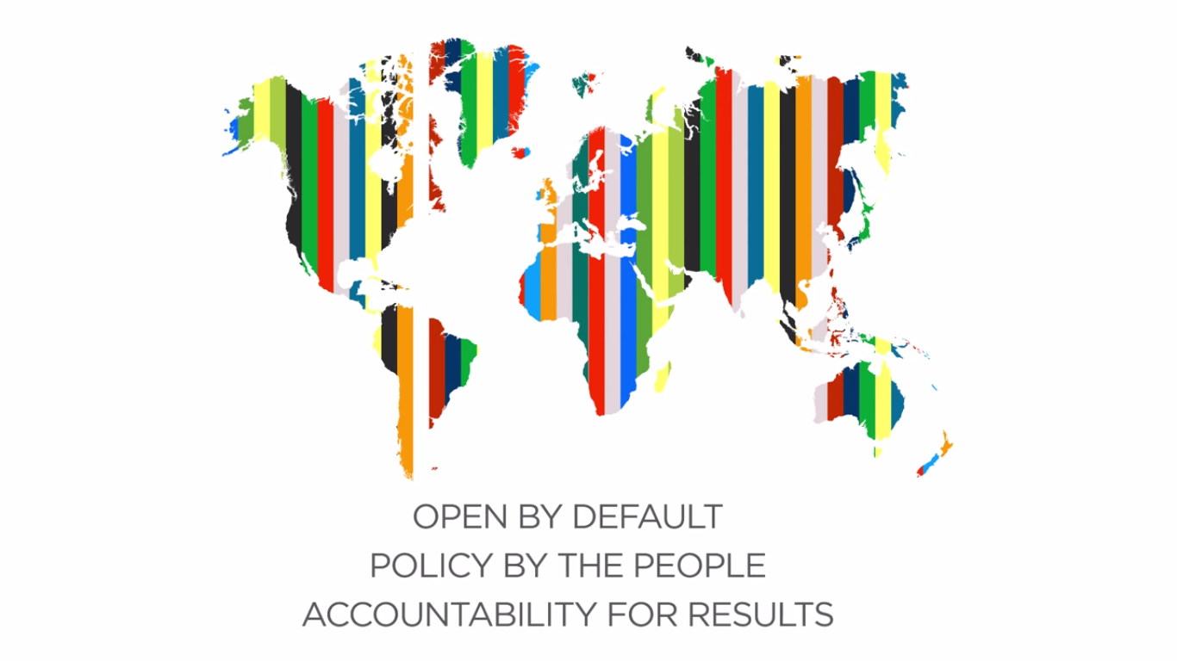
Open Government Partnership 101
Emilene Martinez Morales
Regional Civil Society Coordinator for the Americas
Open Government Partnership
Support Unit

Slide 2
Brief History of OGP
September 2011
OGP is launched in NYC led by Presidents Obama and Rouseff and heads of state and ministers of 44 countries.
.
February 2011
The OGP Steering Committee is created, eight countries join the initiative.
January 2011
In a meeting with government and civil society stakeholders OGP is created.
July 2011
First international gathering of eligible countries.
Notes:
In January 2011, a small group of government and civil society leaders from around the world gathered in Washington DC to brainstorm how to build upon growing global momentum around transparency, accountability and civic participation in governance. The governments included Indonesia, Mexico, Brazil, Philippines, Norway, the US and the UK. Experts included MKSS, the international budget partnership, revenue watch, the open society foundations, twaweza and others.
After sharing their practical experiences driving the open government agenda forward in recent years, the group decided the momentum was ripe to launch the Open Government Partnership (OGP), a new multi-stakeholder coalition of governments, civil society and private sector actors working to advance open government around the world – with the goals of increasing public sector responsiveness to citizens, countering corruption, promoting economic efficiencies, harnessing innovation and improving the delivery of services.
From February 2011 onwards, OGP began developing the basic structure of the initiative, including minimum eligibility criteria to ensure that all member countries demonstrated a basic commitment to the principles of open government and the requisite political will to drive reform.

Slide 3
UNGA 2011

Slide 4
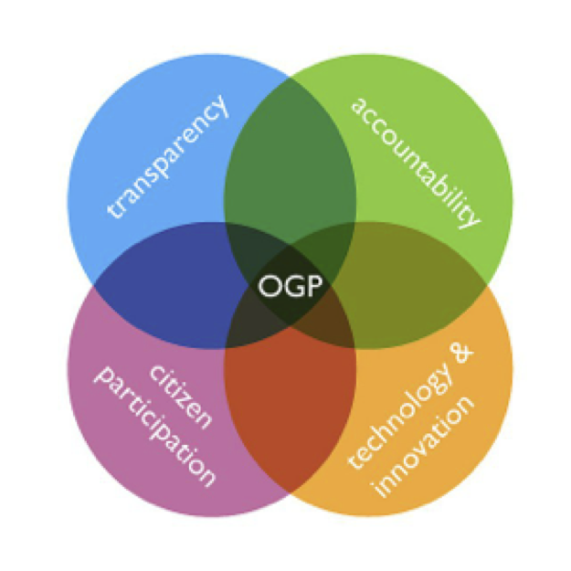
OGP Basics
Global voluntary multi-stakeholder initiative
Partnership between Government and Civil Society
Make governments more open, accountable, and responsive
Promoting Open Government as a tool for better development & social outcomes that we all care about
transparency
accountability
citizen participation
technology & innovation
Notes:
The Open Government Partnership is a global voluntary multi-stakeholder initiative, it is a partnership between government and civil society and seeks to make governments more open, accountable and responsive. We also seek to promote open government as a tool for better development and social outcomes that we all care about. We work based on four pillars of open government: transparency, accountability, citizen participation and technology and innovation.

Slide 5
Eligibility Criteria
https://docs.google.com/spreadsheets/d/1HG66aDufI6BK0RnG-gOruWR8Lz-oVzwZde-tsTaZHrw/edit#gid=869039115
Budget Transparency
Measured by the Open Budget Index (100 country survey)
$

Access to Information
Measured by Right2Info’s database of FOI laws and constitutional provisions for access to information
☼
Asset Disclosure
Measured by the World Bank’s Public Officials Asset Disclosure database
_
Citizen Engagement
Measured by the Economist Intelligence Unit’s Democracy Index
Notes:
Eligibility to join OGP is determined by evaluations of countries’ performance in these four critical areas of open government:
access to information (whether a country has a constitutional provision, draft law under parliamentary consideration or law on access to information)
fiscal transparency (whether the executive budget proposal and audit report are published on a timely basis as assessed by the Open Budget Index
asset disclosure (whether there is a law requiring disclosure, and if there’s requirement for the information to be made publicly available, as World Bank’s Public Officials Financial Disclosure database )
citizen engagement (based on scores from the EIU Democracy Index’s Civil Liberties sub-indicator)
Countries can earn a total of 16 points for their performance in these four metrics, or 12 points if they are not measured in one of the metrics. Countries that earn 75% of the applicable points (either 12 out of 16 or 9 out of 12) or more are eligible to join.

Slide 6
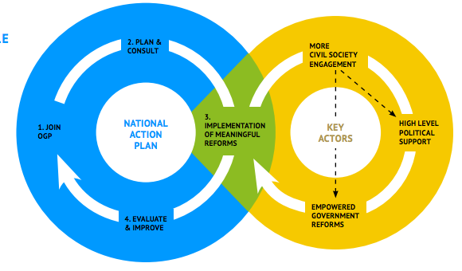
The National Action Plan Cycle
Notes:
Once a country is eligible to join OGP they commit to consult civil society and develop a 2-year action plan with concrete commitments related to transparency, access to information, accountability and citizen participation. Those commitments are then implemented and finally they are evaluated. Lessons learned from this cycle will hopefully allow us to improve over the next cycles. Key actors are needed for all this to succeed: civil society engagement, high-level political support and empowered government reformers.

Slide 7
Big Picture Results
36
152
Countries with a regular forum for dialogue between govt & civil society
National Action
Plans
2700+
Total commitments
since 2011
71
25%
countries
Of commitments
recognized for their ambition, relevance and completion
20
Average commitments
per country

Slide 8
Commitments in Numbers
109
Action Plans
2,500+
Commitments
Public Participation
305
Open
Data
244
Budget Transparency
204
Public Service Delivery
165
Access to Information
132
Data from 2015.
Notes:
Regional insights:
Same top 5 for Americas and Europe, ranking of top 5 differs
For Asia Pacific, top 5 does not include open data and access to info, but does include natural resources and public procurement
For Africa and Middle East, top 5 does not include access to information but includes natural resources

Slide 9
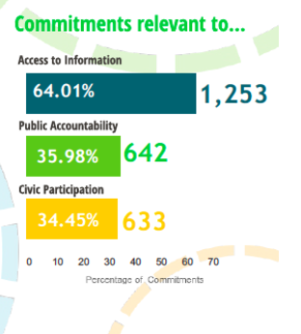
Commitments Relevant to…
152
Action Plans
2,700+
Commitments
IRM Data from December 2016.
Notes:
Regional insights:
Same top 5 for Americas and Europe, ranking of top 5 differs
For Asia Pacific, top 5 does not include open data and access to info, but does include natural resources and public procurement
For Africa and Middle East, top 5 does not include access to information but includes natural resources

Slide 10
Action Plan Guidelines
OGP Consultation Guidelines
1. Availability of timeline & process
Make details & timeline of consultation available (online at minimum) prior to consultation
2. Adequate notice
Consult the public with sufficient forewarning
3. Awareness raising
Conduct awareness raising to increase participation
4. Multiple channels
Consult through various mechanisms: online and in-person
5. Breadth of consultations
Consult widely with the national community including civil society and private sector
6. Documentation & feedback
Make a summary of public consultations and feedback available publicly
7. Consultation during implementation
Identify a forum to enable regular multi-stakeholder consultation

Slide 11
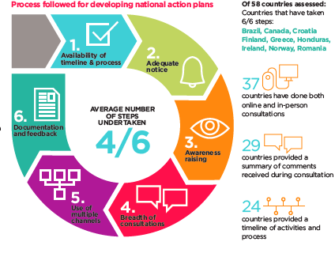
OGP Consultation Guidelines
OGP Civil Society Survey 2015

Slide 12
What is the IRM?
Independent Reporting Mechanism to hold OGP governments to account and learn
Is formulation, implementation and monitoring of action plan collaborative and open?
Are action plans relevant, accountable and verifiable?
Are more ambitious actions getting done?

Slide 13
IRM Reports
Progress Report – 1st year of Action Plan implementation
End of Term Report – full Action Plan cycle

Slide 14
IRM Progress Reports
Process and consultation:
Development of action plan
Implementation of action plan
Government self-assessment
Implementation:
What were the commitments?
Are they complete?
Did they matter?
Context and next steps
Notes:
CHANGE SLIDE: Add a screenshot the cover of your report to introduce your report and discuss what it evaluated.
Suggested topics to discuss (these points may need separate slides):
Did the government do what they said they would do?
Does your country Action Plan have a theme? Particular focus on issue areas or sectors?
Has the government consulted with civil society on development of the Action Plan?
Which CSOs were invited?
Was the process collaborative?
Is there a permanent dialogue forum to monitor the implementation of the Action Plan?

Slide 15
Quality Control
National researcher
IRM program staff
International Experts Panel
Government and Civil Society
Public comments

Slide 16
Data collection methods
Desk research – government self-assessment, reports of implementing agencies, CSO reports
Interviews with civil servants, CSOs, experts, beneficiaries
Stakeholder focus group
Surveys
Field test (user-perspective check)

Slide 17
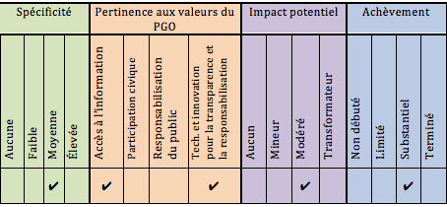
How are commitments evaluated?
Notes:
CHANGE SLIDE: Add a screenshot or bullet points to discuss your reports key findings

Slide 18
Starred Commitments
Relevance
Ambition
Specificity
Completion

Slide 19
Starred Commitments
Relevance
Ambition
Specificity
Completion

Slide 20
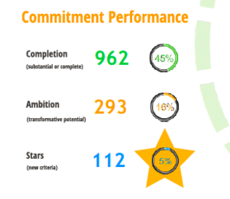
Commitment Performance

Slide 21
The OGP Explorer
http://www.opengovpartnership.org/blog/paul-maassen/2015/05/28/introducing-ogp-explorer

Slide 22
How does OGP work for Civil Society?
OGP Civil Society Survey 2015

Slide 23
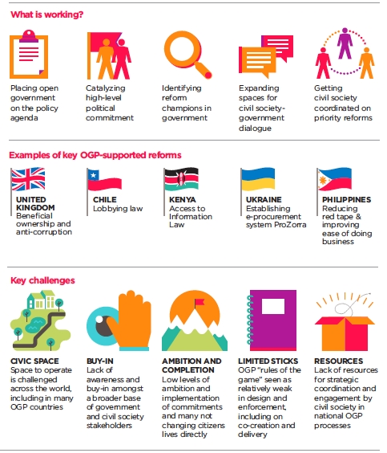

Slide 24
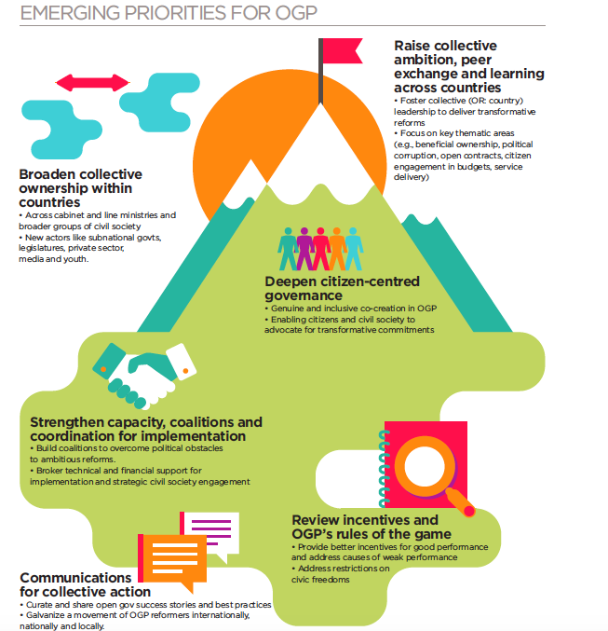

Slide 25
The Open Government Partnership
OGP Steering Committee
Support Unit
Independent Reporting Mechanism (IRM)
Civil Society Engagement
Government Support and Exchange
Comms
Operations

Slide 26
emilene.martinez@opengovpartnership.org / @emi202 / www.opengovpartnership.org

