Slide 1
Climate Data – And where to find it
Telling stories with data
Johannes Friedrich, Associate, World Resources Institute

Slide 2
Why data in stories
Data can
Make your story stronger
Be your story
Draw the audience deeper

Slide 3
Some Examples of stories
Carbon emissions: past, present and future – interactive
Infographic: What Do Your Country's Emissions Look Like?
The Global Food Challenge Explained in 18 Graphics

Slide 4
Whats the story
Climate Change
Climate Impacts
Climate Action / Solutions
Sectors - Energy, Forests, Health, …
Individuals / Countries / Global

Slide 5
An ocean of information
Use your Google-fu!
Climate, energy,
+ finance, policy, impacts,
+ data, visualization
Or
“Top 10 emitters”, “China GHG emissions”, “Deforestation visualization”,

Slide 6
Some examples of Sources
Emissions & Policy
http://cait.wri.org/
http://climateactiontracker.org/
Social Economic:
http://data.worldbank.org/topic/climate-change
Climate Finance:
climatepolicyinitiative.org
Weather/Climate
http://www.ipcc-data.org/
Forests
http://www.globalforestwatch.org/
Impacts
http://www.prepdata.org
http://www.wri.org/our-work/project/aqueduct

Slide 7

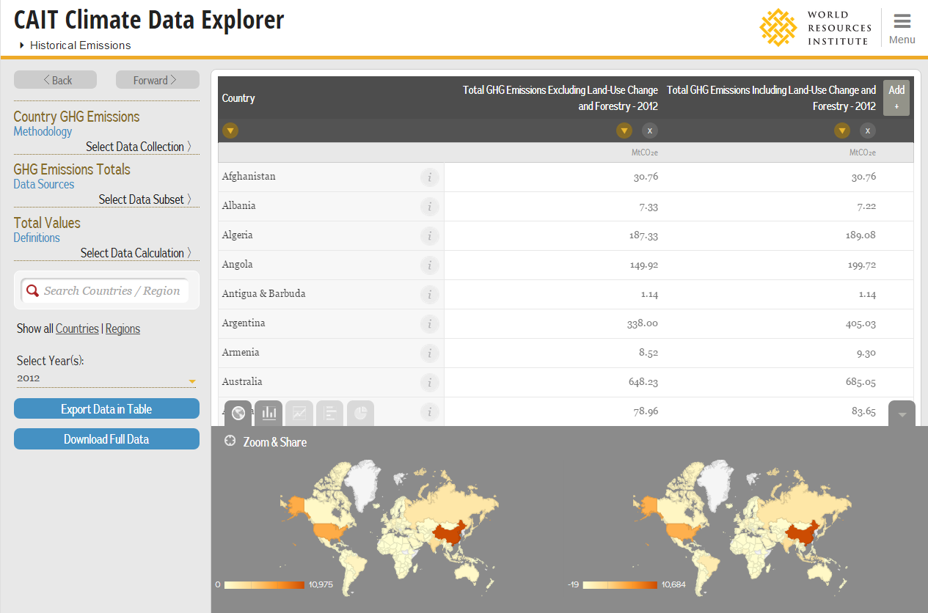
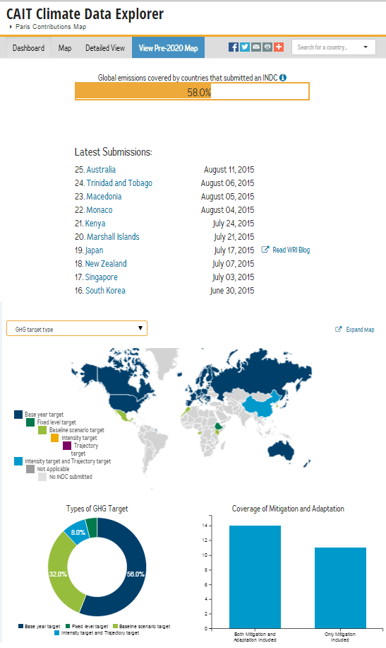
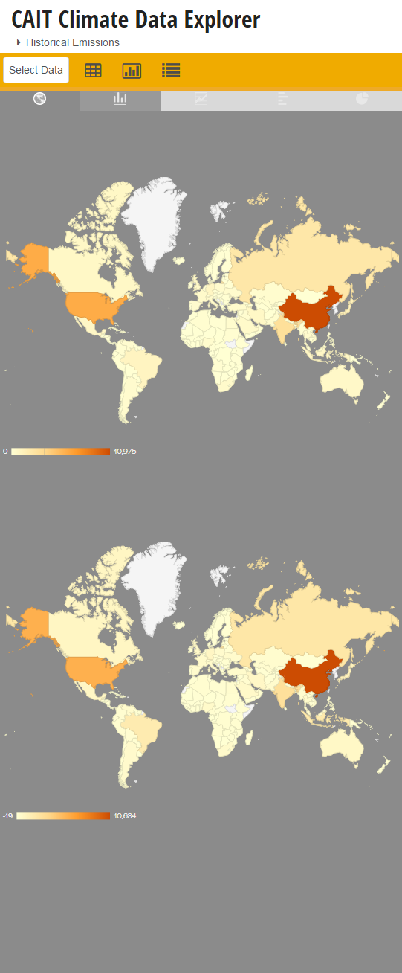
CAIT Climate Data Explorer

Slide 8
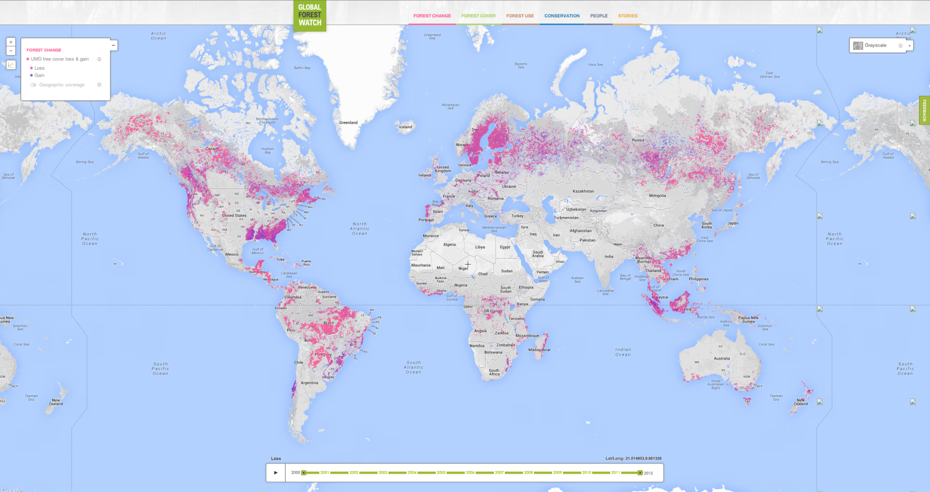
Global Forest Watch

Slide 9
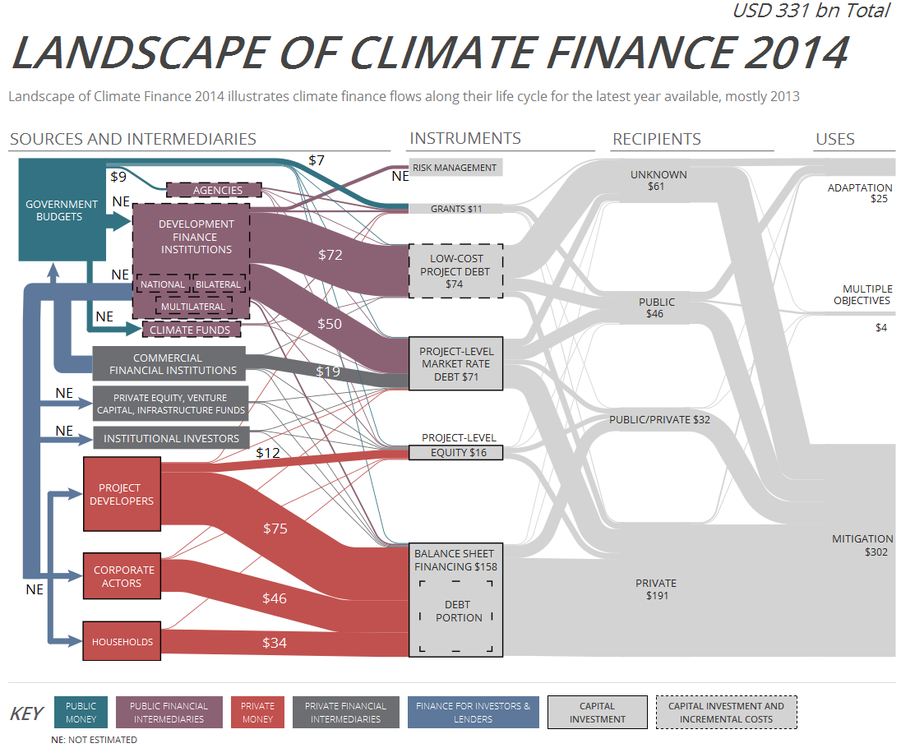
Climate Finance

Slide 10
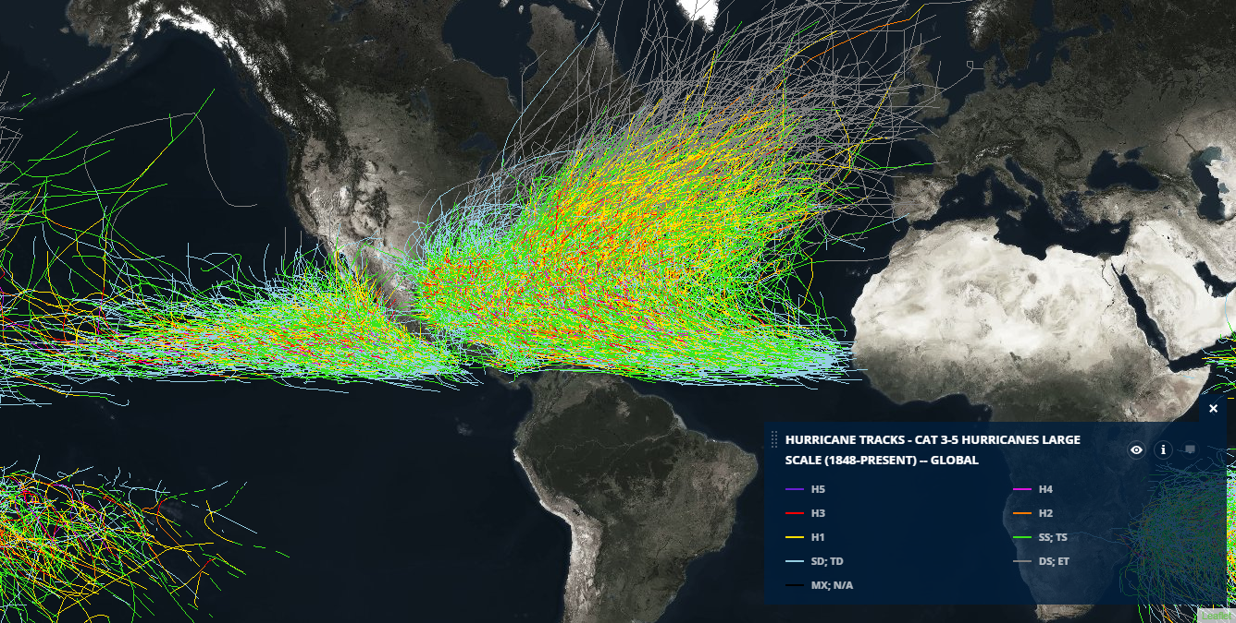
The Partnership for Resilience and Preparedness (PREP)

Slide 11
Getting started – Use Examples
http://www.informationisbeautiful.net/
http://www.highcharts.com/
https://d3js.org/
https://www.coursera.org/learn/datavisualization

Slide 12
Conclusions
Data can make your story stronger or can be your story
Charts, maps and visualizations!
Google it or ask an expert

Slide 13
Questions

