Slide 1

Data journalism projects
Romina Colman - LA NACION DATA

Slide 2
Got an idea?

Slide 3
Sorry, you still don't have a data journalism project

Slide 4
List your ideas
Check their factibility.
Don't fall in love with them.
Learn to let them go if you have to (that is journalism too).

Slide 5

Argentine campaign finance data
http://www.condistintosacentos.com/wp-content/uploads/2015/03/fiscalizacion-.jpg

Slide 6
Learn about the that thing you want to write about

Slide 7

http://www.lovethispic.com/image/181154/let-me-google-that-for-you

Slide 8
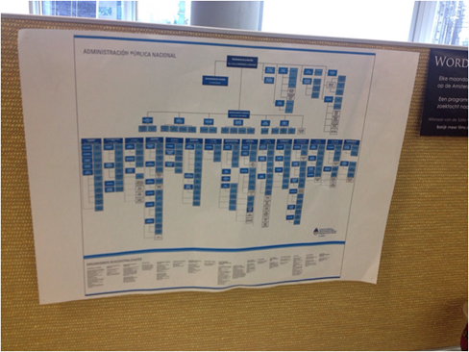
Where is the information I am are trying to find?

Slide 9
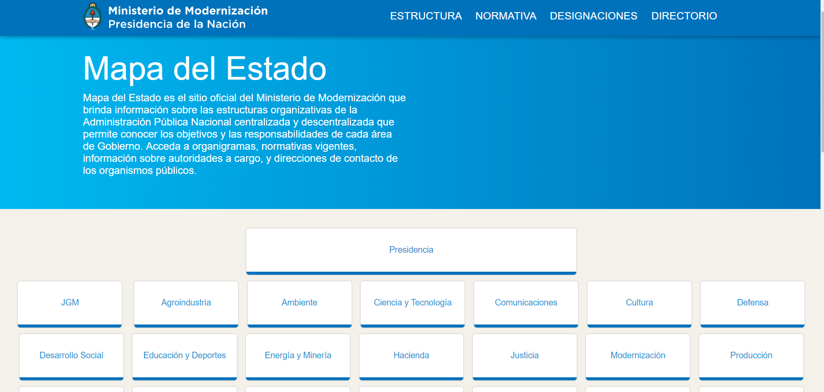
You may think it´s easy, but look closer

Slide 10
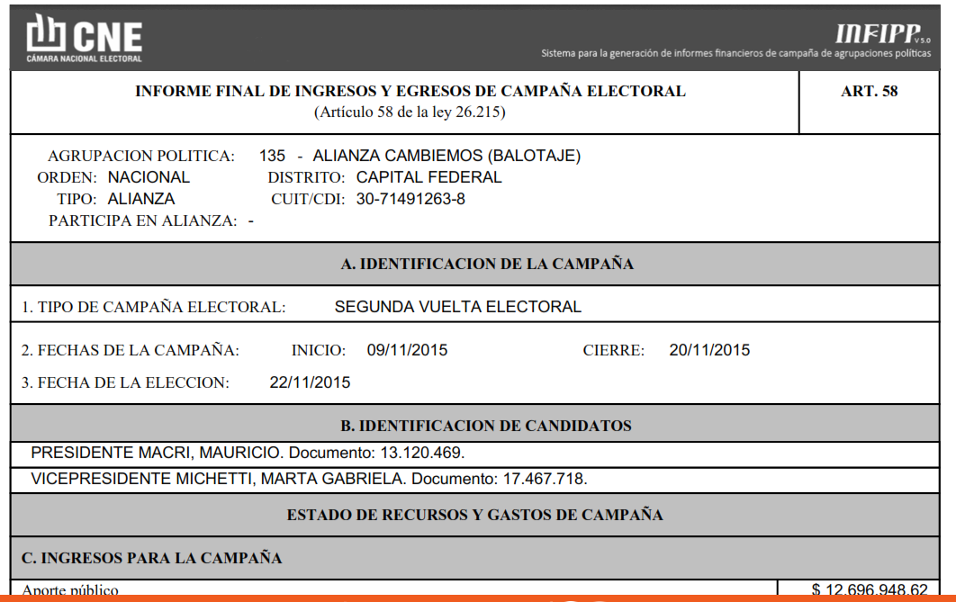
The documents

Slide 11
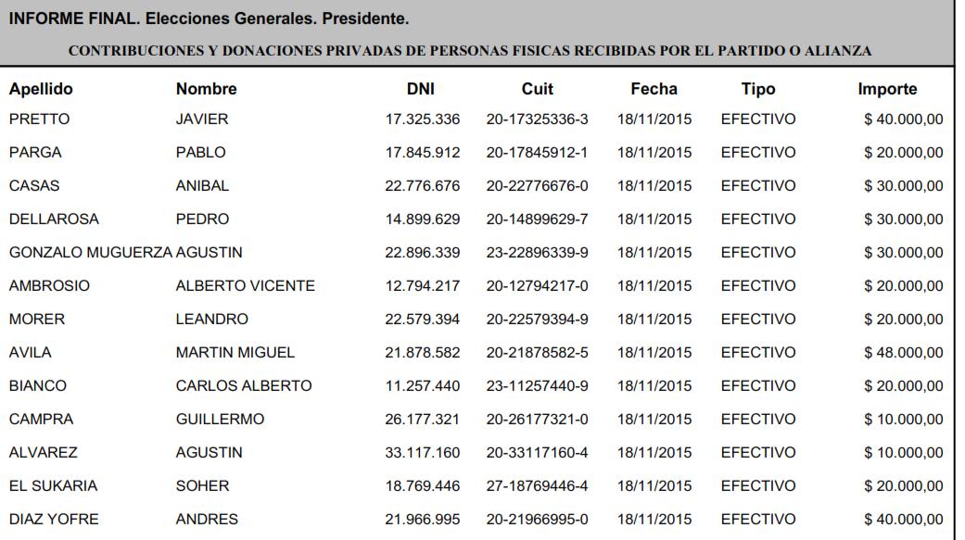

Slide 12
Try to quantify the time you will need for the story

Slide 13
Test the documents
YES
Several times

Slide 14
Try to answer the following questions
What kind of information is there?
What doubts you have about certain points of that data?
Make sure you get answers from your questions
Talk to experts.
Don't take anything for granted.

Slide 15
And now what? Be prepared for challenges

Slide 16
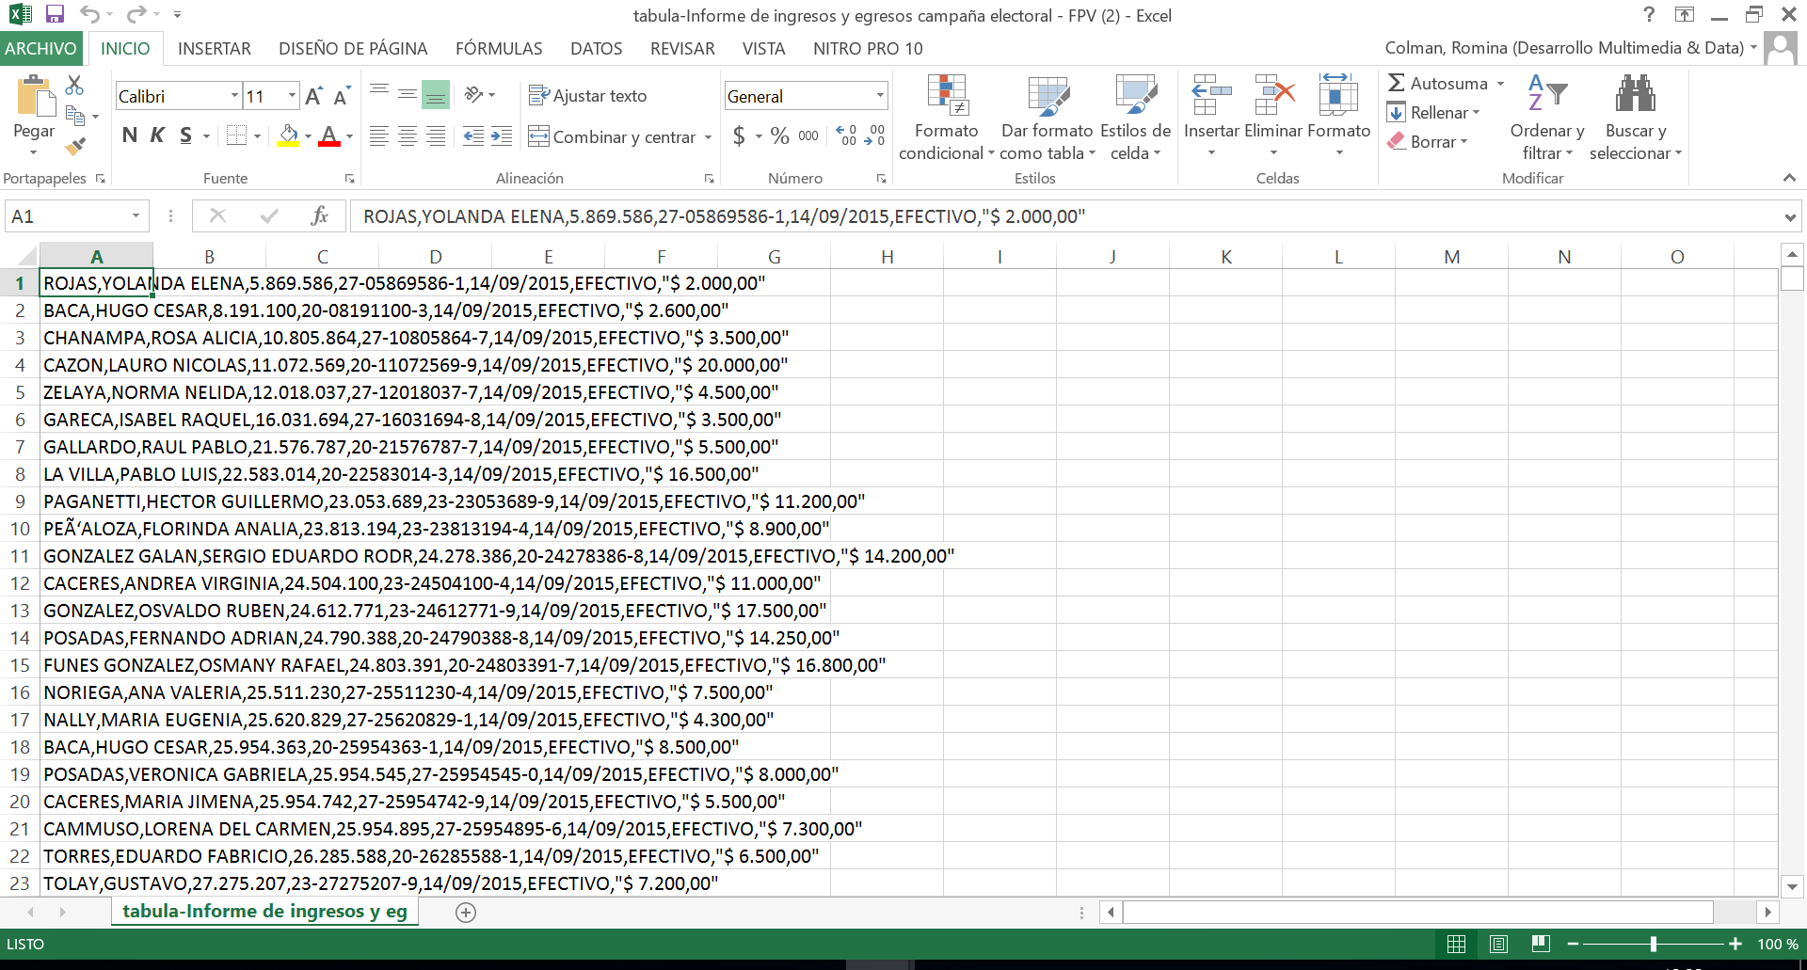

Slide 17
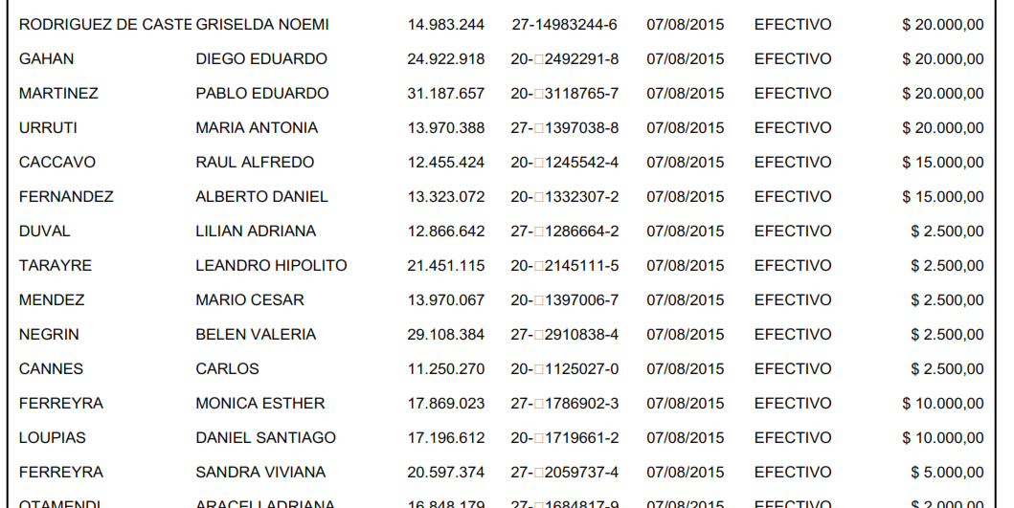
I really hate PDFs!

Slide 18
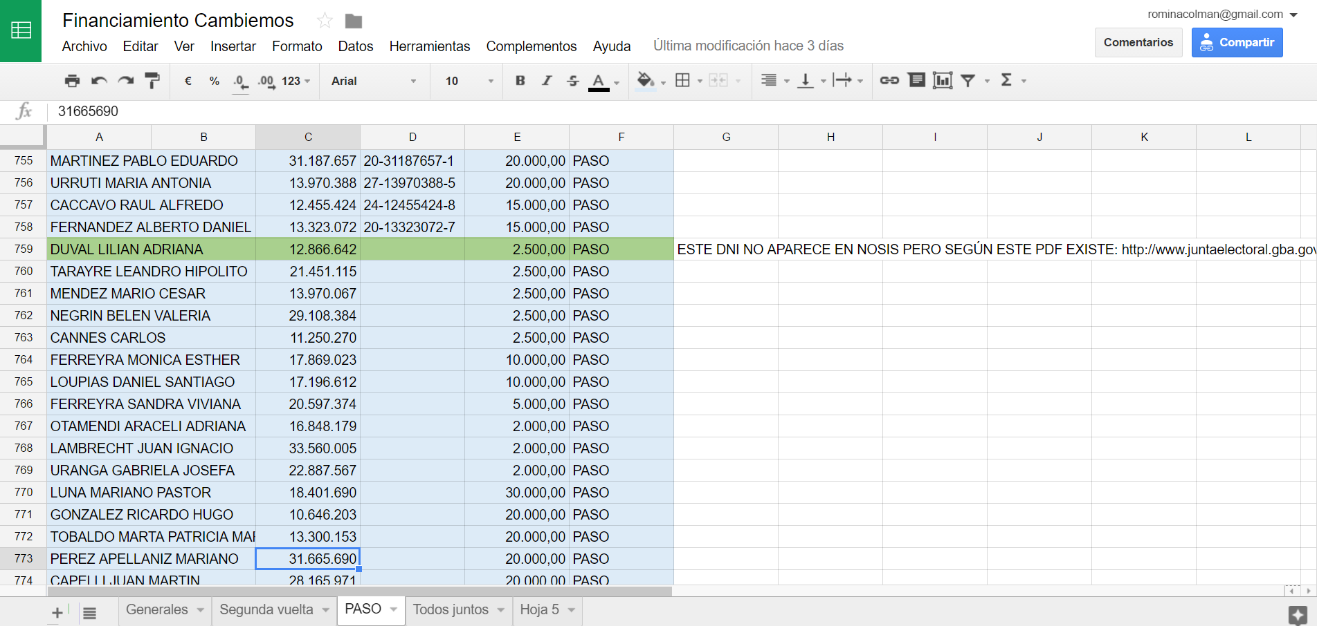

Slide 19
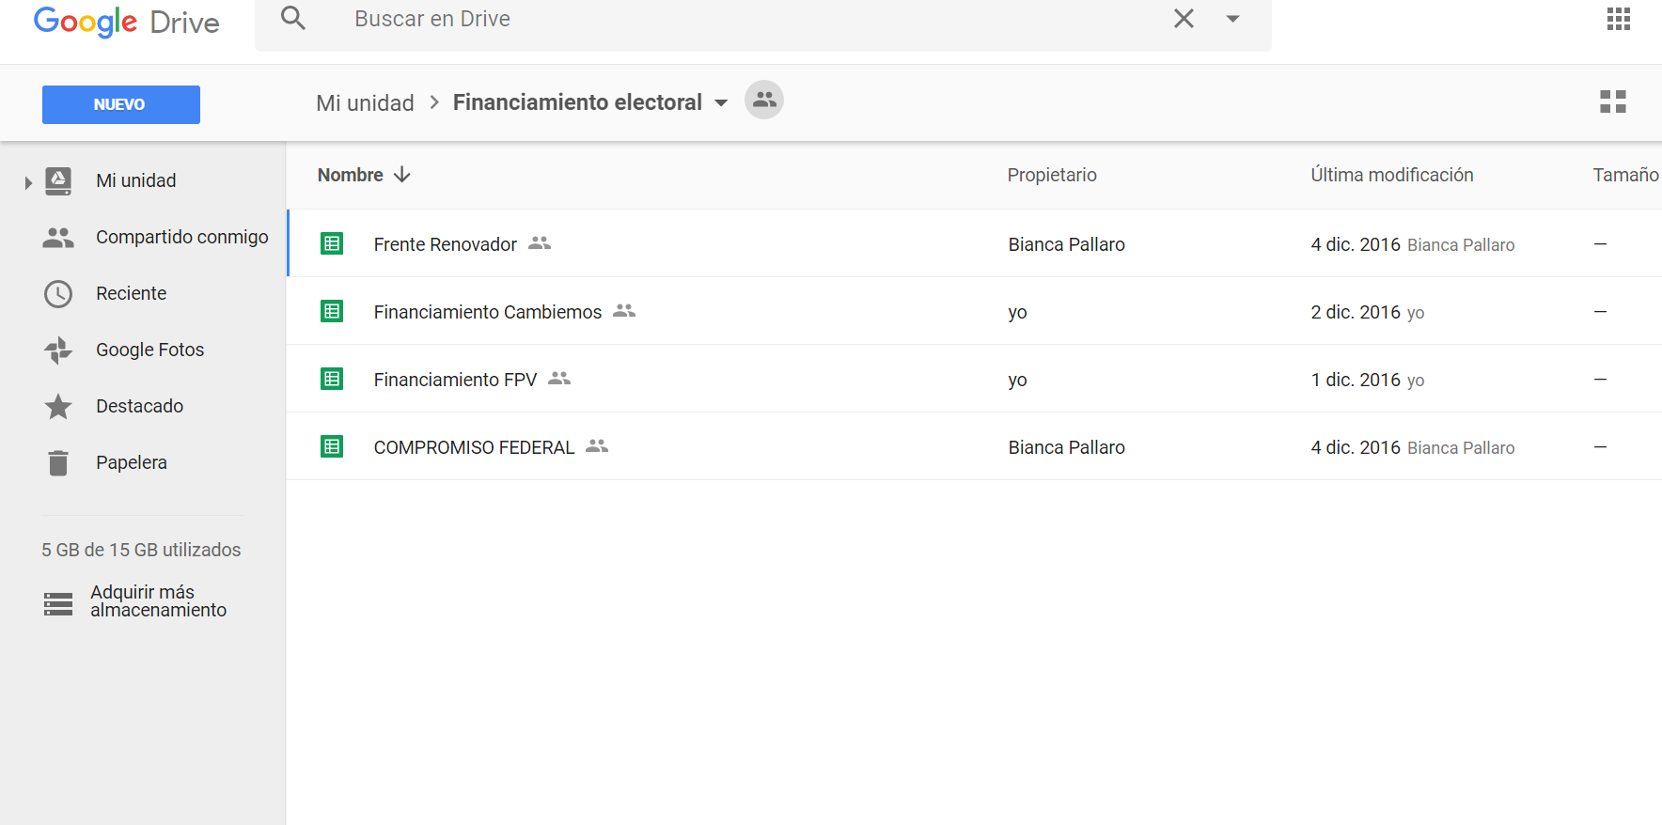
Make a plan
Organize the project in different stages (less is more).

Slide 20
“I want to tell people the full story about…”

Slide 21
Check, check and check..

Slide 22
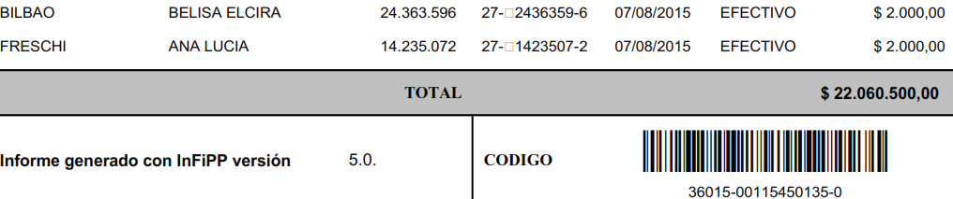

Slide 23
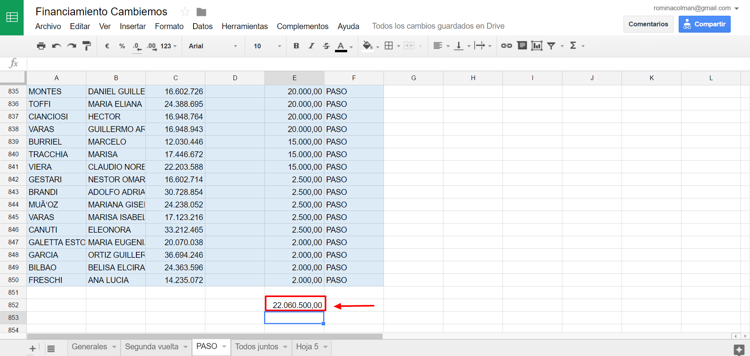

Slide 24
Let the documents rest every once in a while

Slide 25
When you work a lot during the day with the same documents, at one point you won't be able to detect mistakes

Slide 26
Don't get desperate when things get bad

Slide 27
Sometimes you will need to do manual work and it´s not really that bad..
(Technology is not everything)

Slide 28
You get to know the documents and you gain special skills that will make the difference in your newsroom

Slide 29
Always get feedback for your project

Slide 30
Be persistent

Slide 31
Always have fun

