Slide 1
Inspiring data journalism stories
Romina Colman - LA NACION DATA
@colmanromi / @LNData

Slide 2
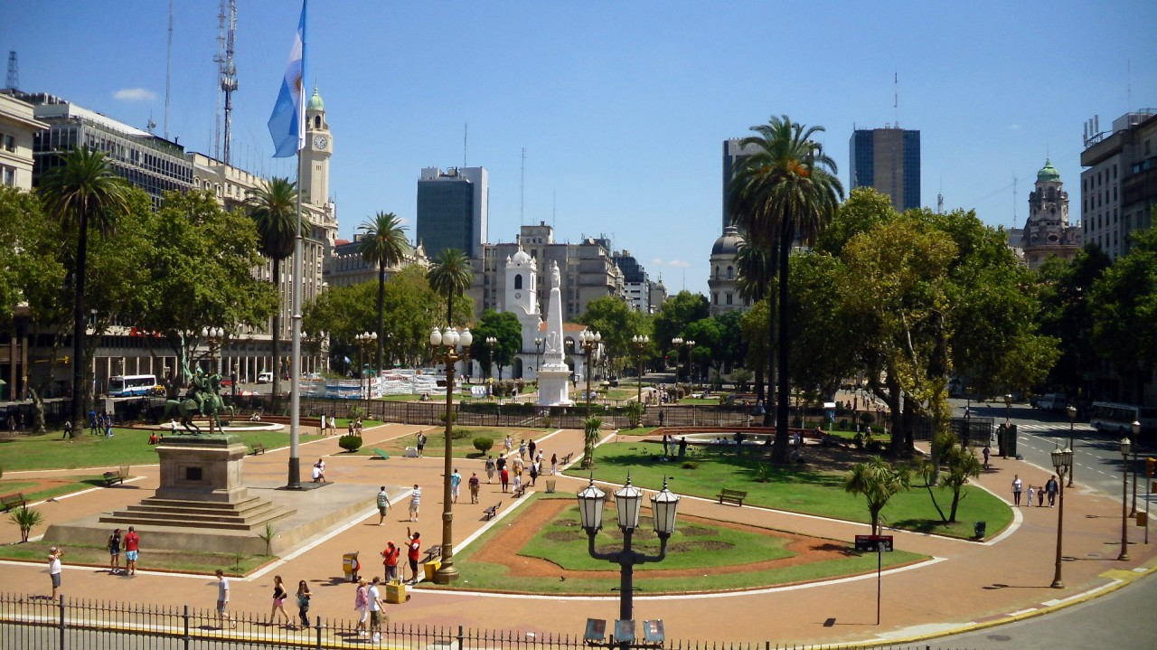

Slide 3


Slide 4
Let’s finish with some myths around data journalism

Slide 5
When people think about data journalism, they usually think this

Slide 6
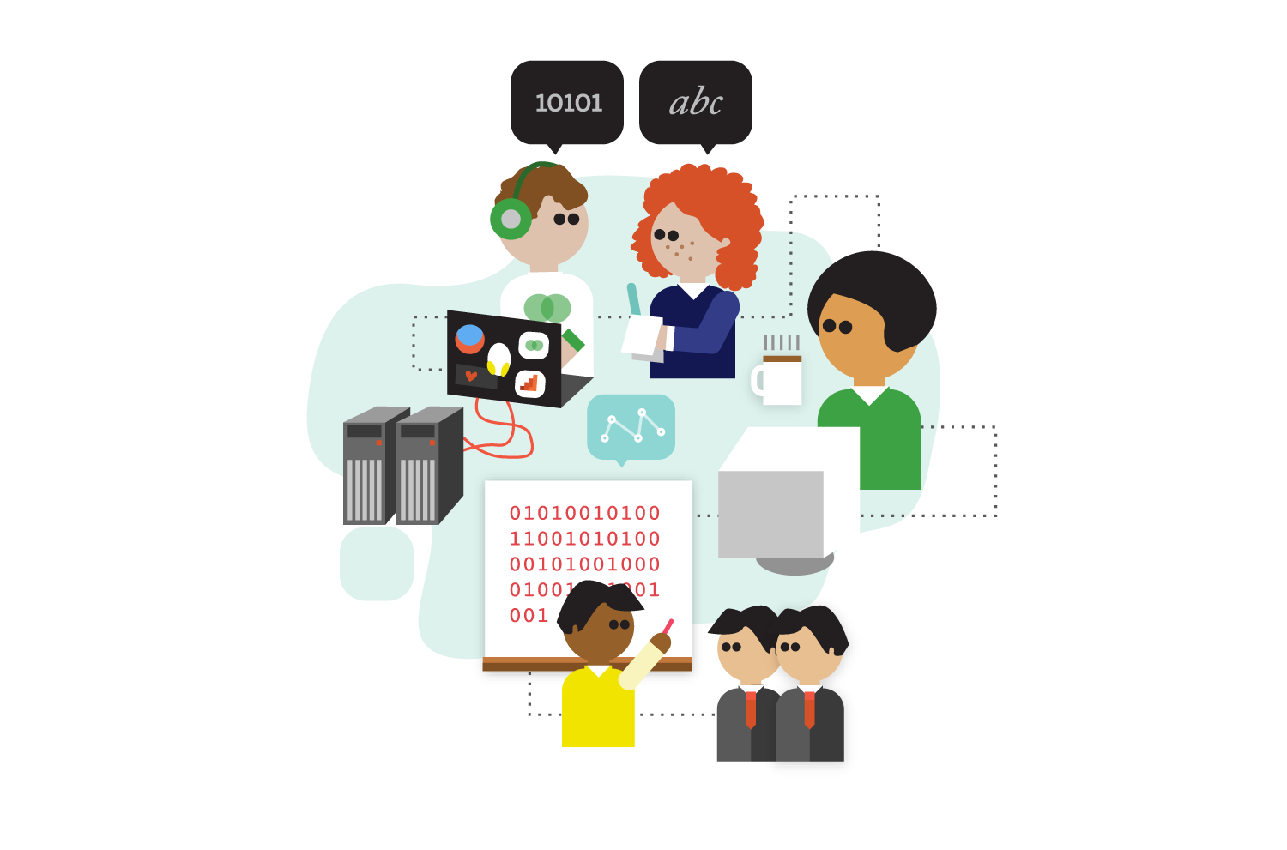
http://datadrivenjournalism.net/news_and_analysis/A_peek_inside_the_Data_Journalism_Handbook

Slide 7
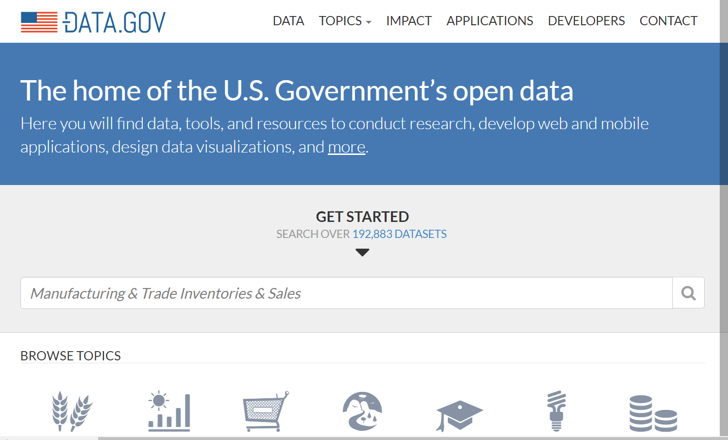

Slide 8
But the truth is that when you work in a data journalism team, you usually have to deal with this

Slide 9
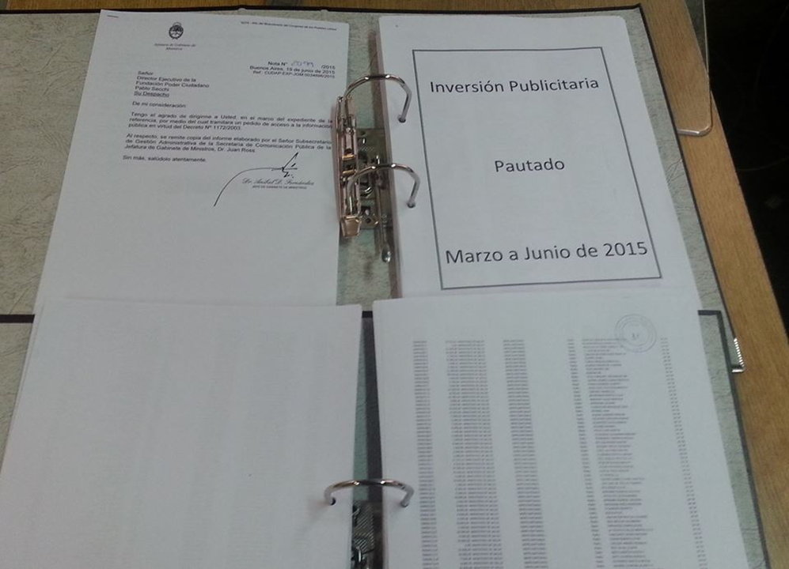

Slide 10
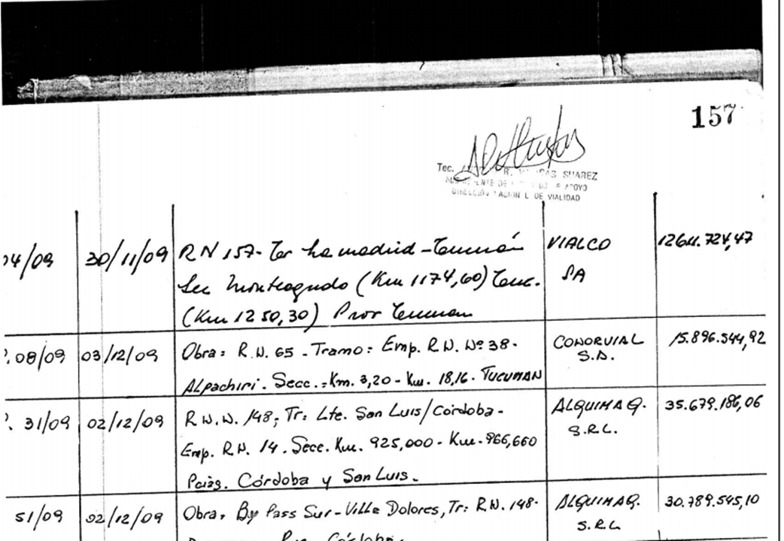

Slide 11

http://www.freejpg.com.ar/free/info/100005292/escritorio-oficina-carta-cartas-papel-papeles

Slide 12
Today I will talk about three stories

Slide 13
What do they have in common?

Slide 14
Stories begin when you start being curious about something

Slide 15

Travels abroad of the President

Slide 16
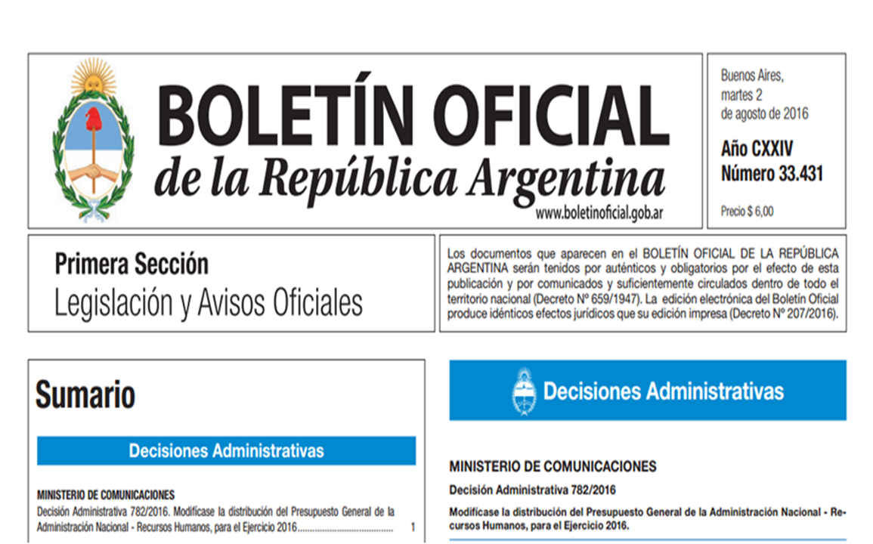

Slide 17
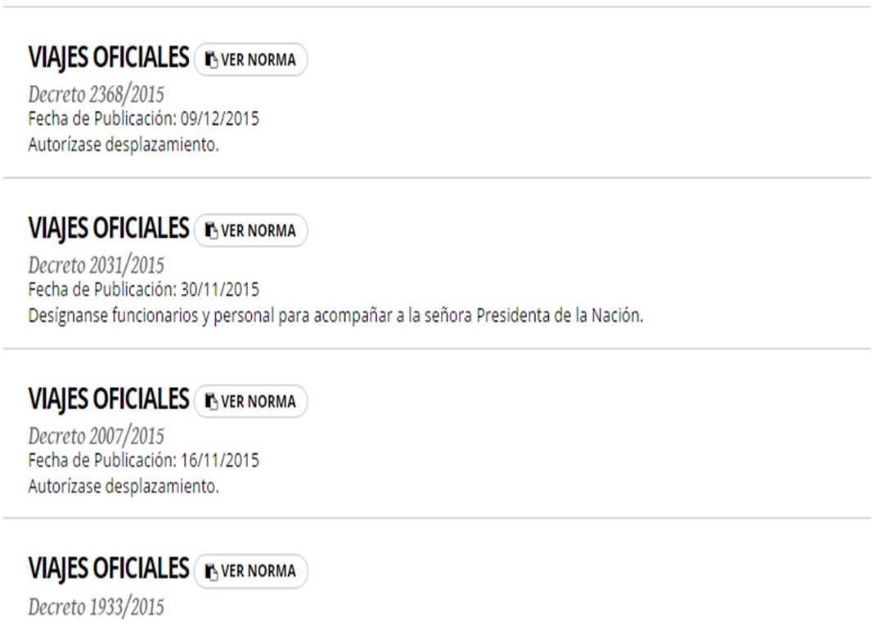

Slide 18
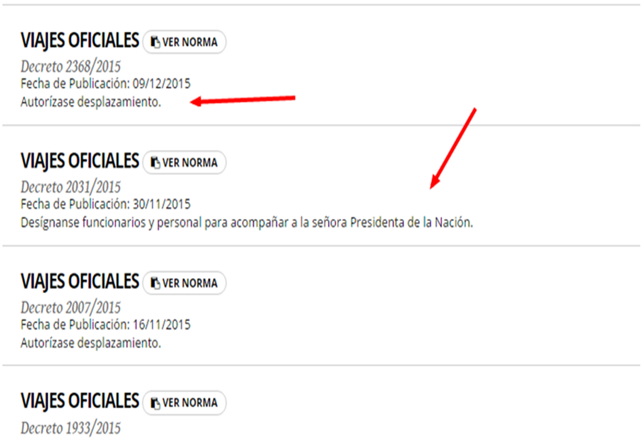

Slide 19
Bingo! There’s a pattern in the documents

Slide 20
Not so fast….

Slide 21
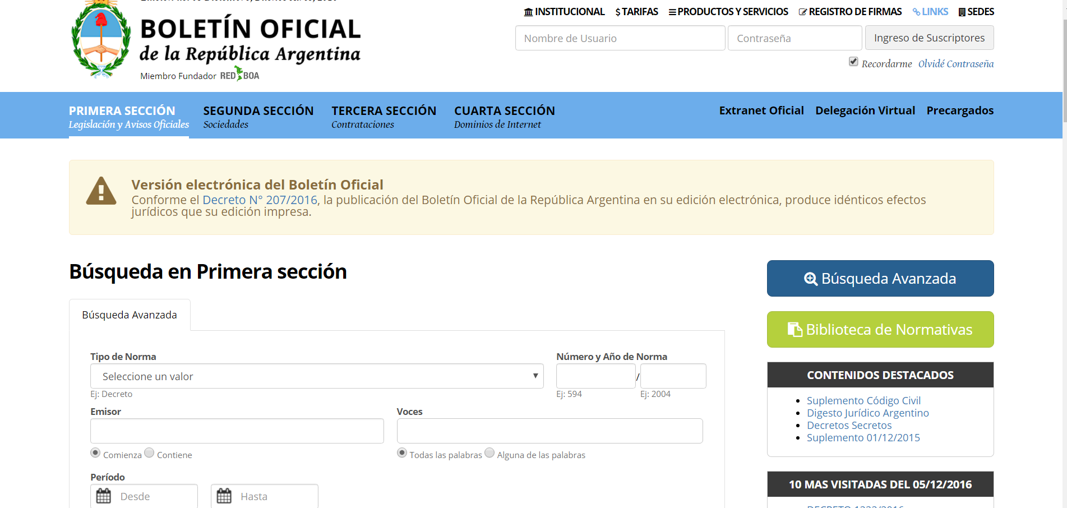

Slide 22
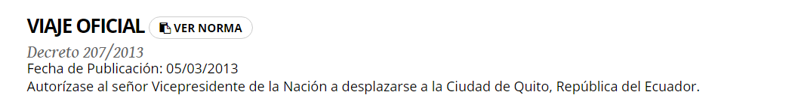
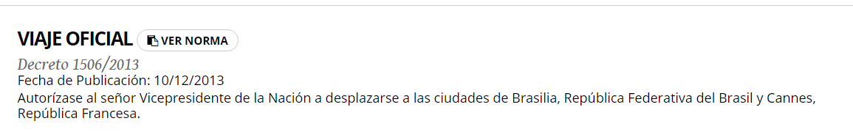

Slide 23
Wait! You already know the documents, start asking questions.

Slide 24
Why?

Slide 25
It will help you decide the best way to build your dataset

Slide 26
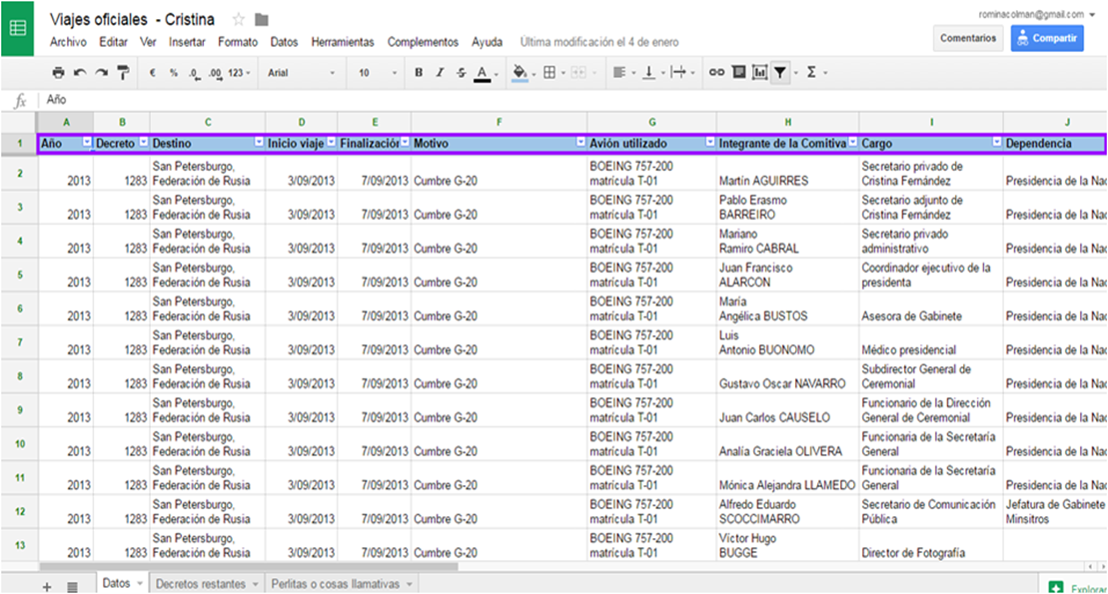

Slide 27
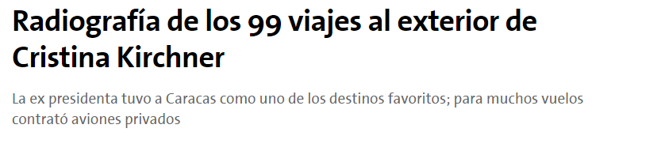
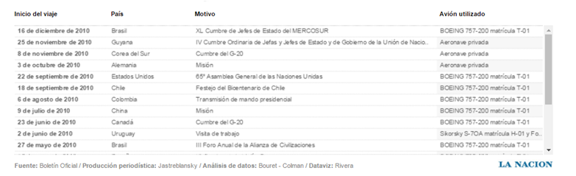

Slide 28
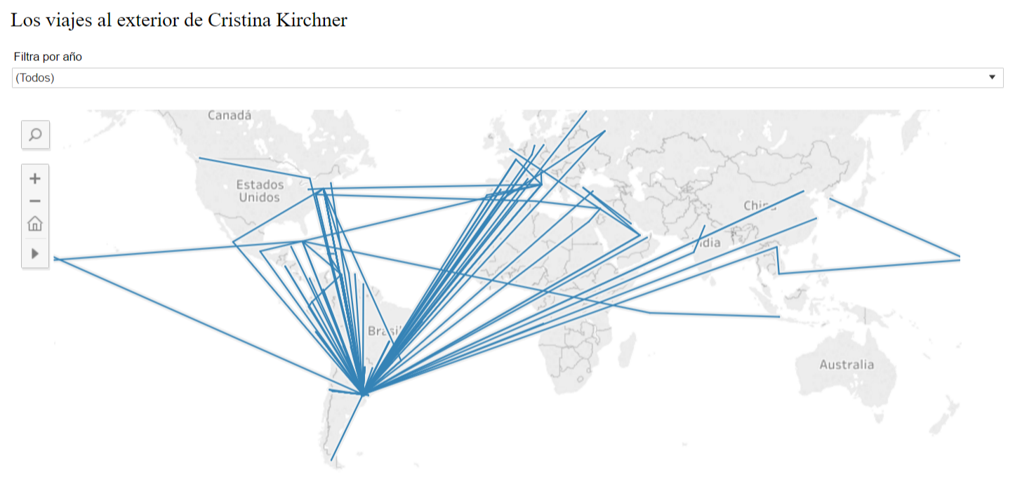

Slide 29
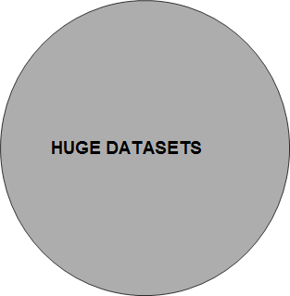
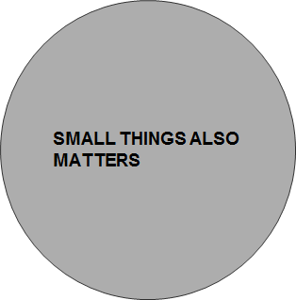
In data journalism...

Slide 30

Every month...

Slide 31
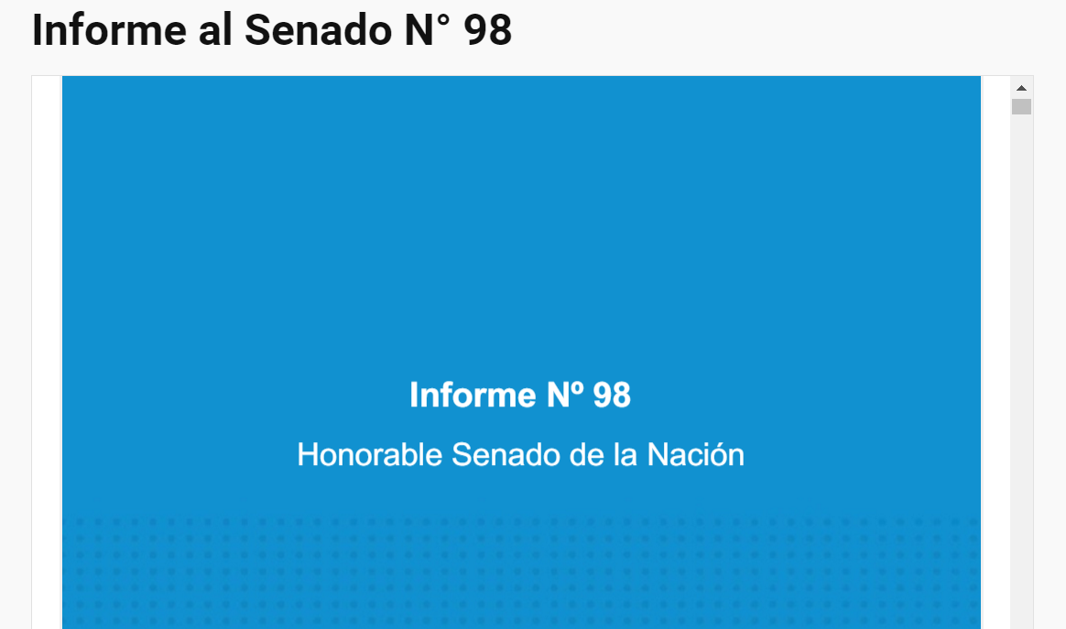

Slide 32
Once a month I spend 9 hours checking all the questions our Congress did to our Cabinet Chief

Slide 33
 It is worth scrolling

Slide 34
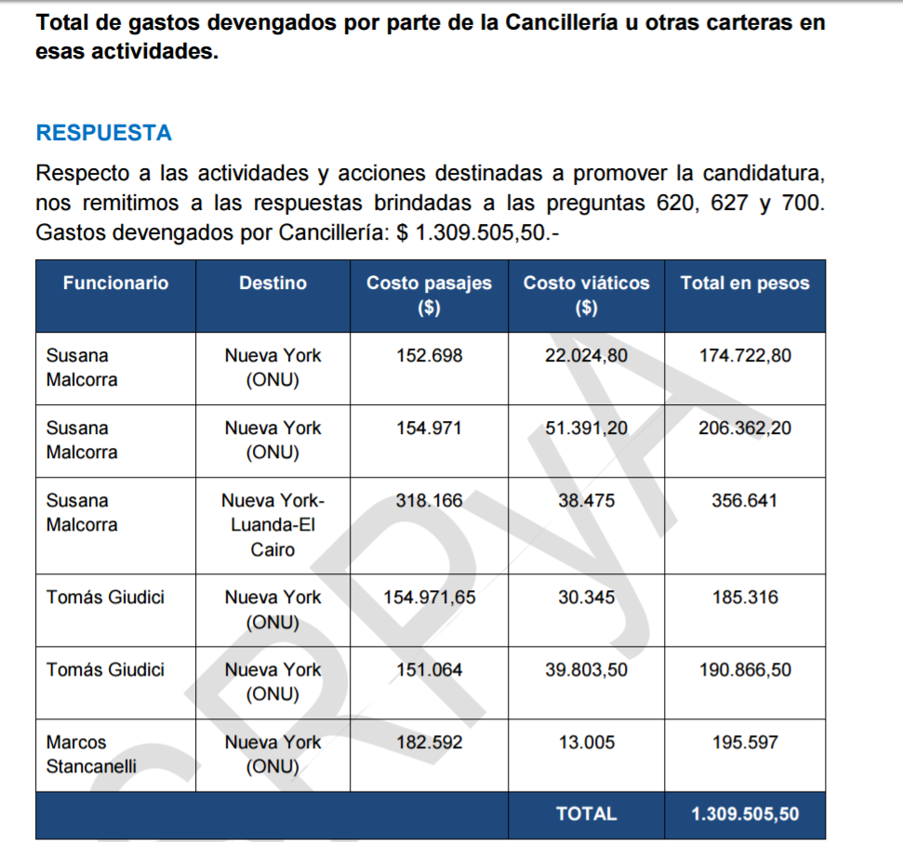

Slide 35
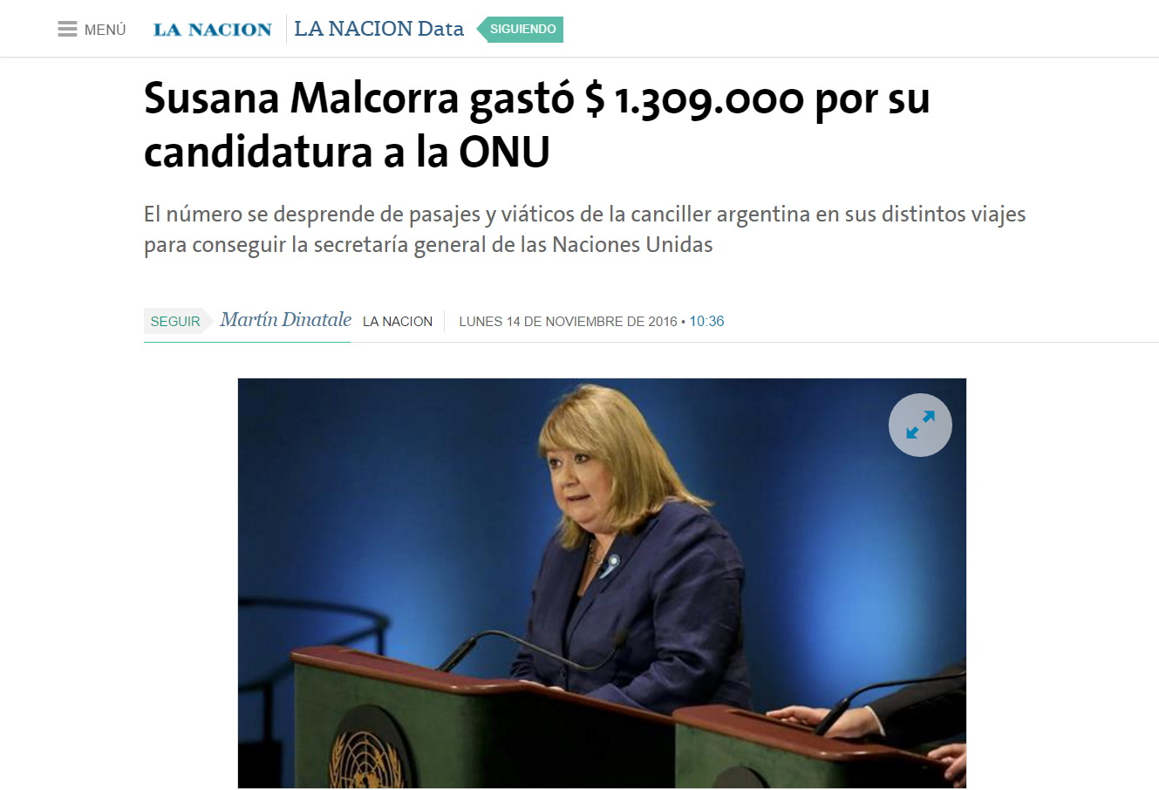

Slide 36
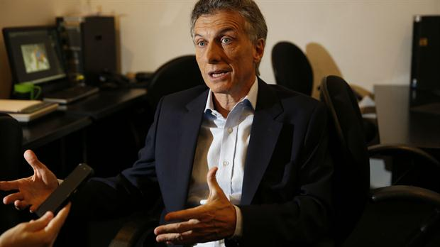
Mauricio Macri’s presidential speeches


Slide 37
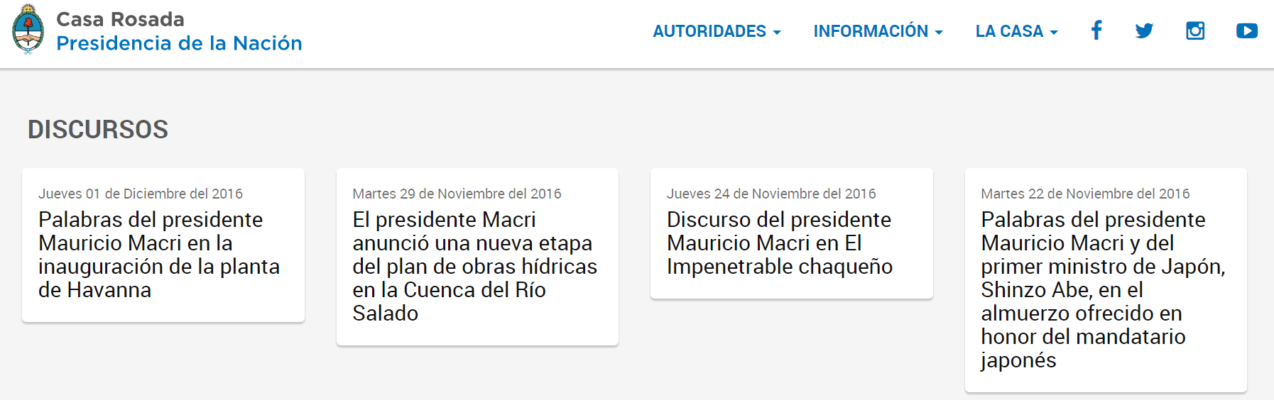

Slide 38
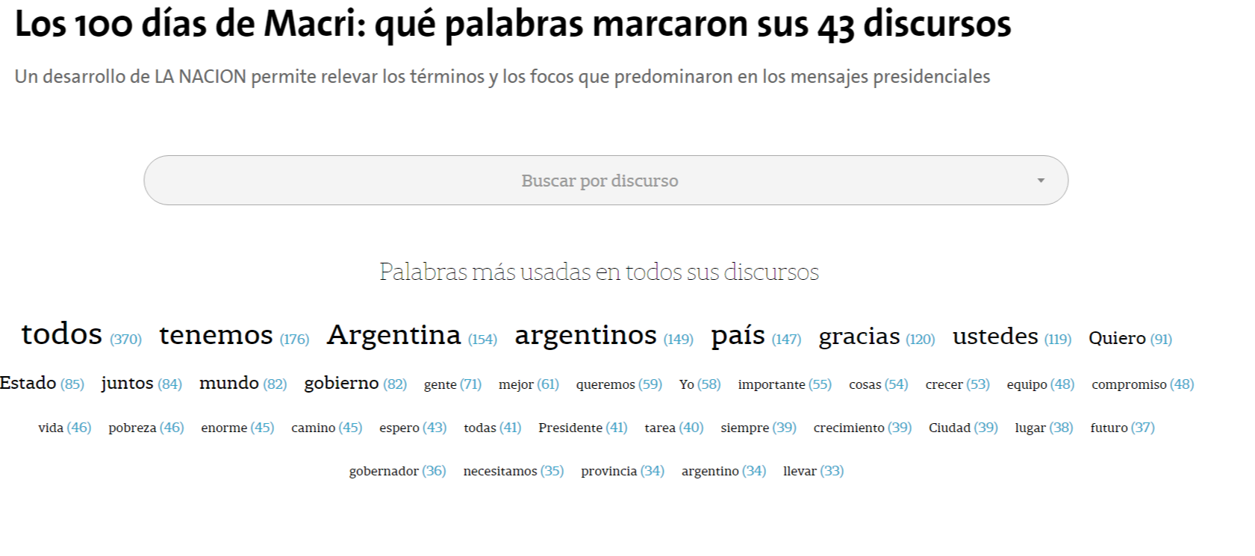

Slide 39
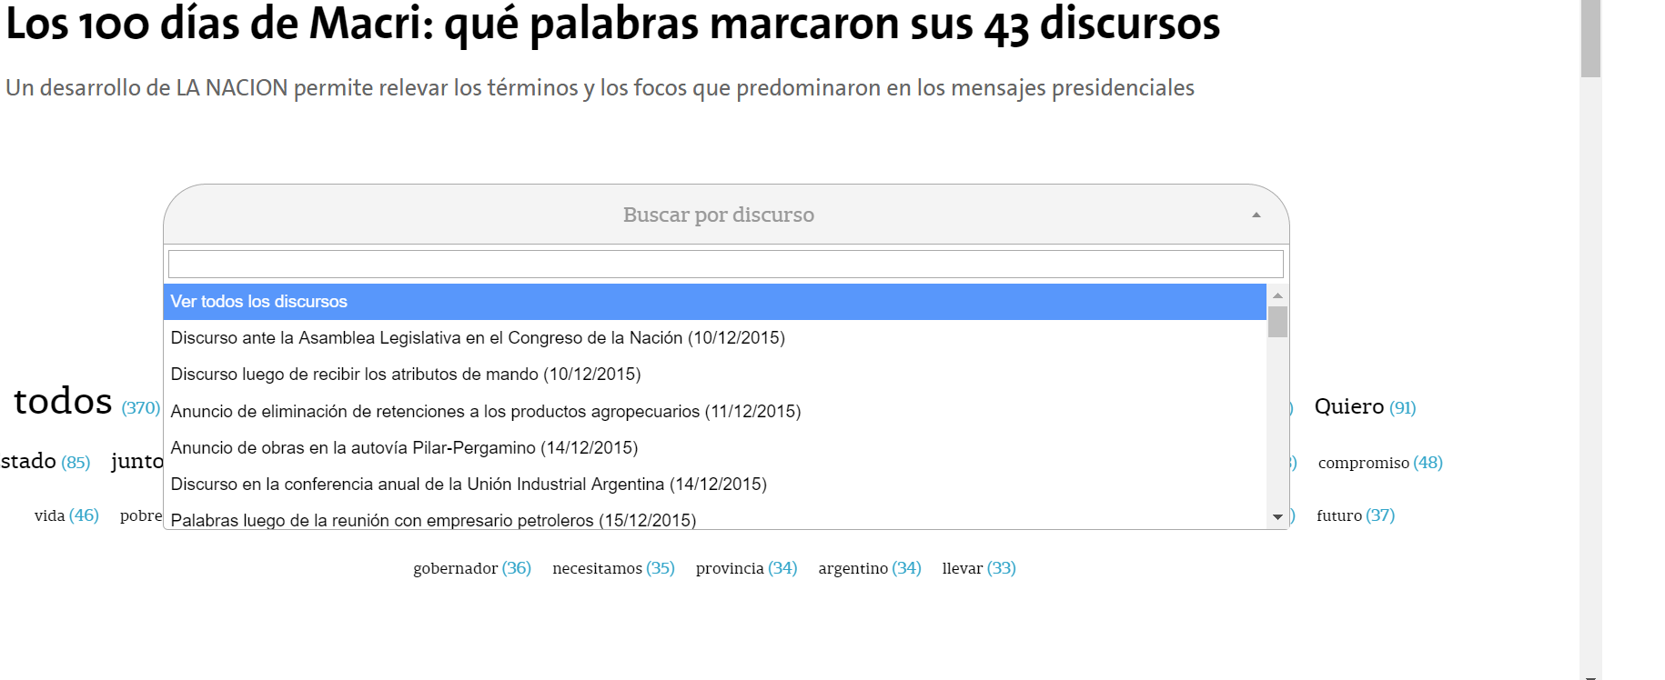

Slide 40
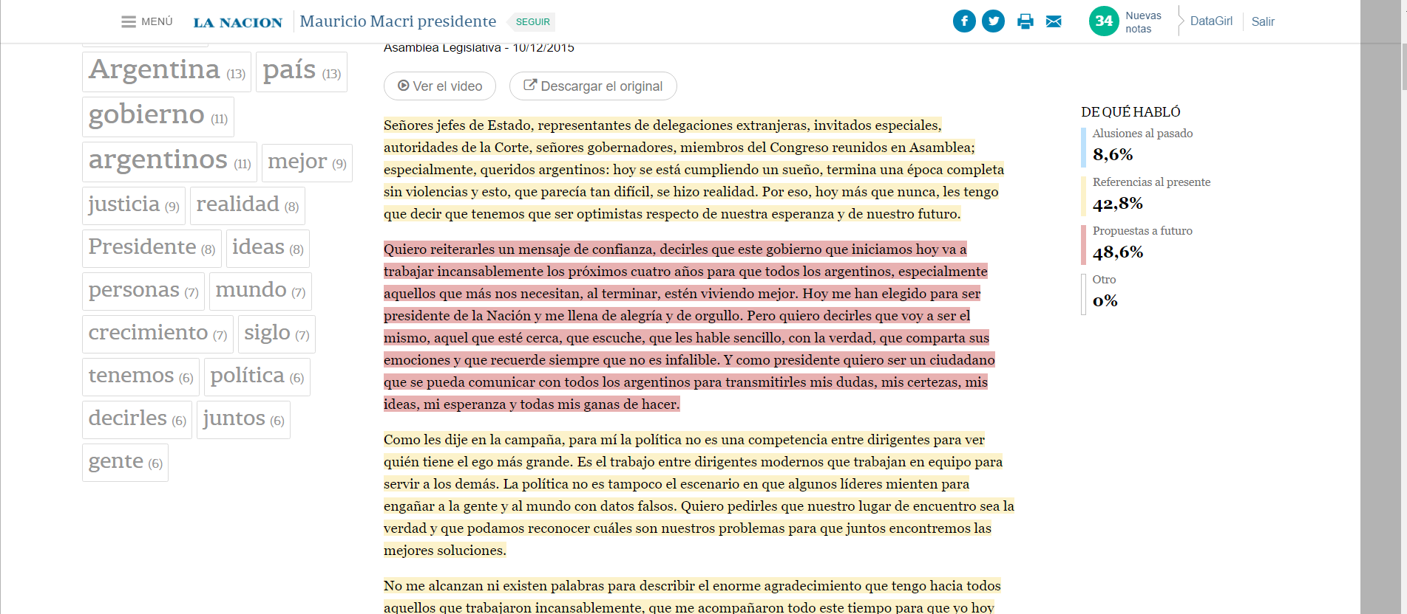

Slide 41
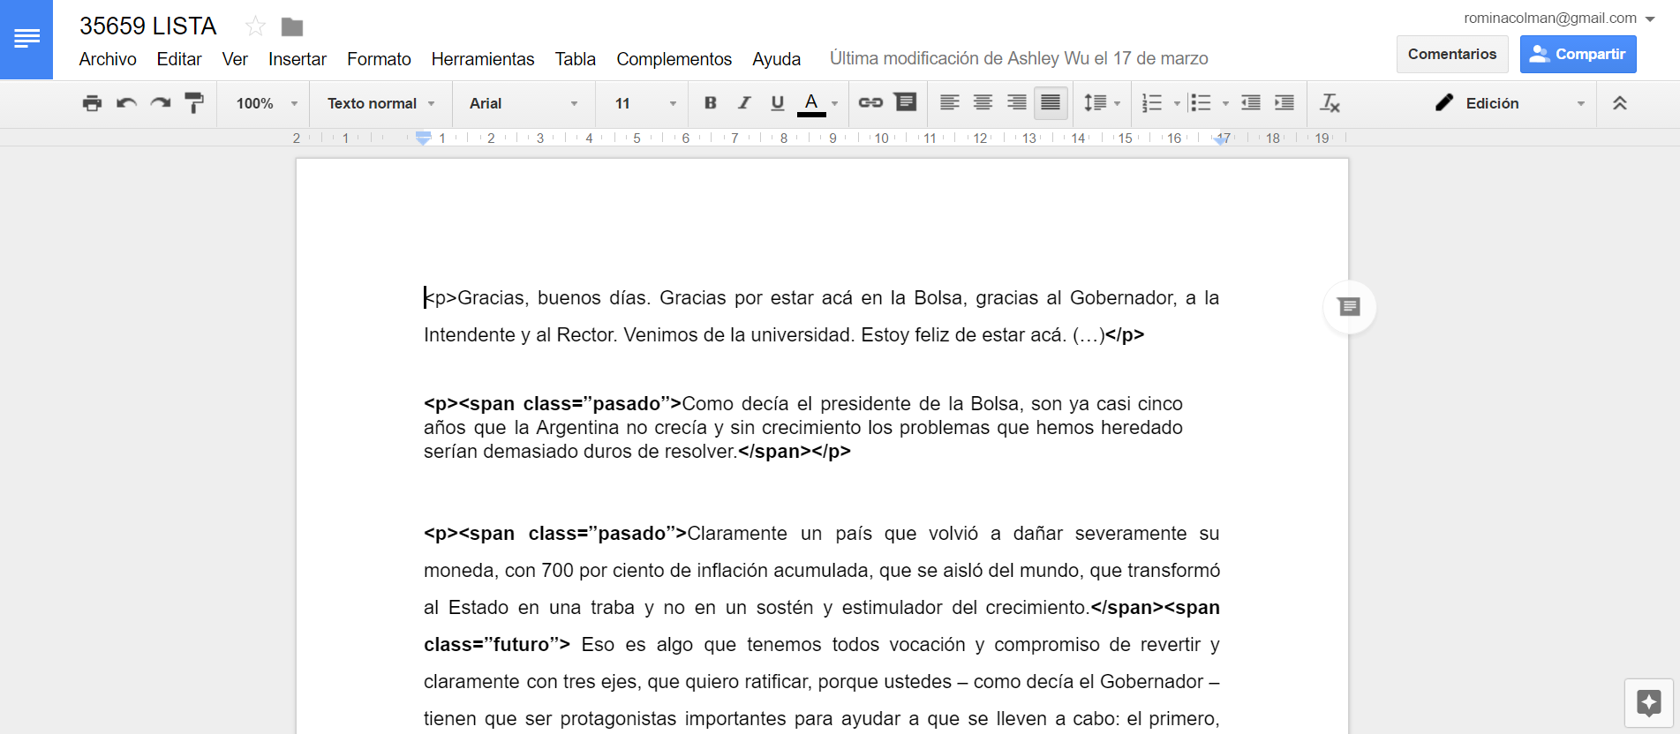

Slide 42
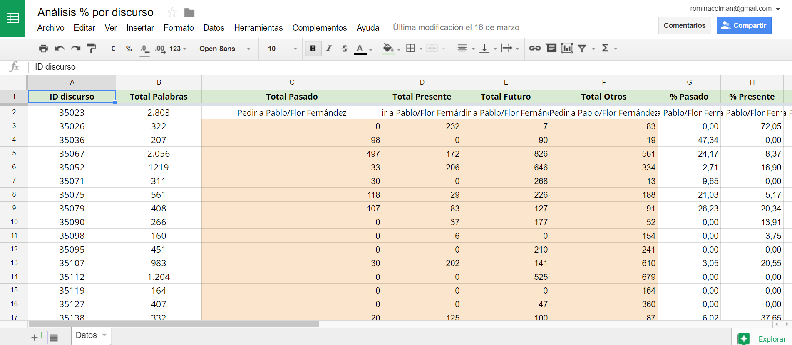

Slide 43
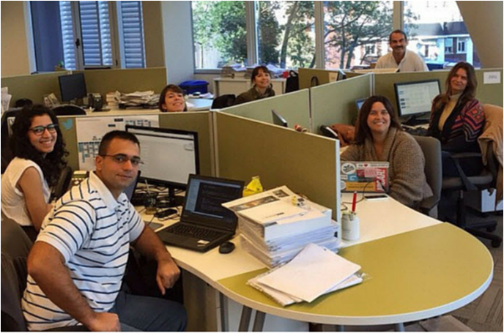
Most important thing in data journalism

Slide 44


