Slide 1
The impact of Open Procurement Data
Lorenza Ponzone
Giampaolo Sellitto
October 21th 2021

Slide 2
20 years of Data Driven Decision Making
  2000 – Public Procurement Oversight in the field of Works
  2001 – Pre-qualification of economic operators for Public Works
  2006 – Procurement oversight (Works, Services, Goods)
  2009 – Green Public Procurement uptake, with the Ministry of environment protection
  2010 – Procurement data for budgeting, with the commissioner for the Spending Review
  2010 – Monitoring Public Money Flows – sharing data with Anti-Mafia Commissioner
  2011 – Setting reference prices for goods and services (mainly in the Health sector)
  2014 – electronic Virtual Company Dossier for Economic Operators
  2015 – Transparency of Public Procurement – Administrations publish data on contracts, yearly
  2016 – Procurement Data accessible on request by Academics, NGOs and other stakeholders
  2017 – Carrying out regulatory impact analysis prior to publishing Guidelines
  2018 – Providing Open Procurement Data to the national Data Portal
  2019 – Open Public Procurement Data
  2020 – Undertaking the first pilot for Red Flags at EU level with Commission and other MS
  2021 – Quantitative Corruption Indicators, linked to environmental factors

Slide 3
Some high impact applications
Encouraging Green Public Procurement uptake (2008-2014, with the Ministry of Environment)
Setting reference prices for goods and services (mainly in the Health sector)
Supporting Italy’s “spending review” by sharing data with other institutions
Carrying out regulatory impact analysis prior to publishing Guidelines
  Providing Open Procurement Data to the national Data Portal
  Undertaking the first pilot for Red Flags at EU level with Commission and other Member States
  Supporting Academics, ONGs and other stakeholders in social impact analyses:
    expenses for hospitality / migrations, procurement under COVID-19 pressure
    uptake of digitalization, eProcurement, savings and impact of centralized procurement
    competition in specific sectors (Health, insurance, logistic services)
  Innovative quantitative approach to corruption (ongoing project funded by PON “Governance and Institutional Capacity 2014-2020” ERDF Fund ASSE 3 – Specific Objective 3.1 Action 3.1.4 Measuring the risk of corruption at territorial level)

Slide 4
ANAC data strategy
Anti-corruption: allow citizens and stakeholders to monitor government (not limited to) spending
Promote awareness of corruption risk in Public Administration, suggest measures
Quantitative indicators (“red flags”) for corruption, beyond Corruption Perception Index
Data driven approach, beyond public procurement
Social and Environmental clauses in Procurement, Responsible approach for PA and Business
Promote civic engagement and public participation in (procurement, but not only) oversight
Open Data to promote participation, National Platform for Transparency
Open Code, capacity building, sharing methodologies, explain the approach
Collaborative oversight with Contracting Authorities, preventive Alternative Dispute Resolution
Digital Innovation and Openness: exploit digital technologies, create awareness
Open code, beyond Open Data, application of standards, cross-border collaboration networks
Services for Public Procurement, Integrity Officers’ Forum, national whistleblowing platform

Slide 5
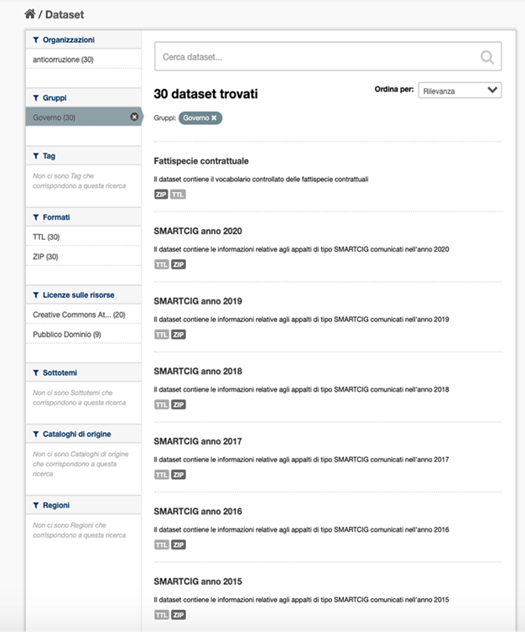
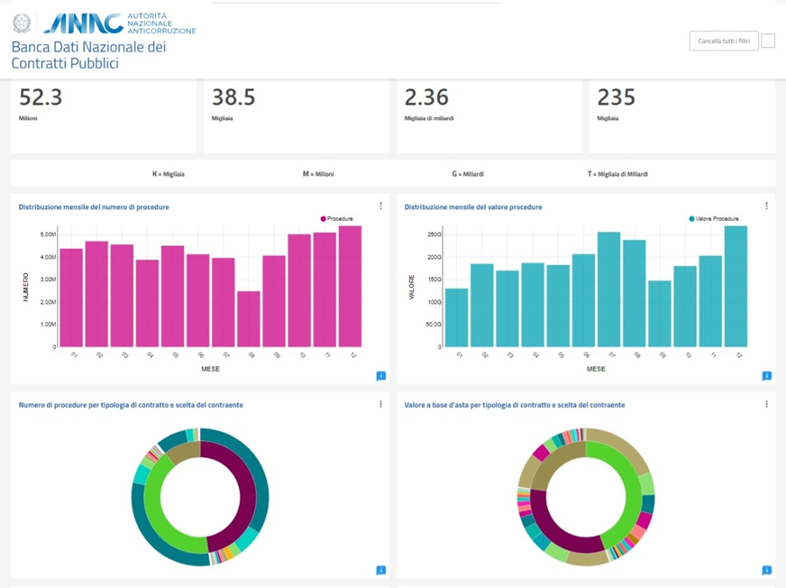
Some key figures about BDNCP
10 years of public contract records
60 million public procurement procedures
5 million public procurement procedures reported in 2020
2,250 billion euros total value
Available as Open Data + Self-service Analytics
https://dati.anticorruzione.it/opendata/
https://dati.anticorruzione.it/superset/dashboard/appalti/

Slide 6
Project "Measuring the risk of corruption at territorial level and promoting transparency”
Promotion of civic participation and investment on dissemination of data on corruption risks.
Construction of a set of corruption risk indicators at territorial level and a set of related social capital and context indicators;
Setting of interoperability between information systems capable of providing dashboards of red flags on corruption and maladministration;
Project “Measuring the risk of corruption at territorial level and promoting transparency” of the National Anti-Corruption Authority (ANAC), funded by the National Operational Programme “Governance and Institutional Capacity 2014-2020” – ERDF Fund – CUP E89G18000140006 – ASSE 3 – Specific Objective 3.1 – Action 3.1.4

Slide 7
Open Data + Open Code for Red Flags
OPEN DATA
BDNCP is available as Open Data, allowing for verification of the results
+ OPEN SOFTWARE
→Business Intelligence and software in «R». The code is open and free
= OPEN KNOWLEDGE
The indicators are an asset for policy makers, academia, NGO’s and citizens

Slide 8
Thank You!
relazioni.internazionali@anticorruzione.it

