Slide 1

BENEFICIAL OWNERSHIP
DATA VERIFICATION SESSION
WESTERN BALKANS REGIONAL MEETING
October 22, 2021
Kyiv (Ukraine)

Slide 2
Recent updates legislation
Implementing the EU Directive 2009/101/EC
provisions into national legislation
New legal framework for financial monitoring
Law of Ukraine “On Prevention and Counteraction to Legalization (Laundering) of Criminal Proceeds, Terrorist Financing, Financing of Proliferation of Weapons of Mass Destruction”
Ministry of Finance of Ukraine Order № 163
Draft Law “On Amendments to Laws of Ukraine on Improving the Validation Mechanisms of Information on the Ultimate Beneficial Owners and the Ownership Structure of Legal Entities” № 6003

Slide 3

Implementing the EU Directive 2009/101/EC provisions into national legislation
the list of information to be disclosed by legal entities, including information about the beneficial owner of the company was extended
a Registry in which the specified information is stored was defined
the opportunity for free access to such information through the review, copying and printing from the Unified State Register is given
it became possible to obtain a copy of documents in paper form, contained in the registration file

Slide 4
Law of Ukraine “On Prevention and Counteraction to Legalization (Laundering) of Criminal Proceeds, Terrorist Financing, Financing of Proliferation of Weapons of Mass Destruction”. Regarding the introduction of the regime of beneficial ownership, the Law defines
data that allows to determine the Ultimate Beneficial Owner
concept of the "Ultimate Beneficial Owner" and "ownership structure"
obligation of the state registrar to check (verify) the Ultimate Beneficial Owner
obligation of legal entities to submit information on the ownership structure, including the nature and extent of the beneficial ownership (benefits, interest, influence, level, degree, share)
obligation of the legal entity to keep this information updated,
administrative responsibility for the failure of the legal entity to submit the data on ultimate beneficial owner
sanction for non-submission of information on beneficial owners entails the imposition of a fine which is equal to one – three thousand non-taxable minimum incomes (555 – 1667 EURO, 1 non-taxable minimum incomes = 17 UAH)

Slide 5
Unified State Register
MOJ has approved updated application forms in the field of state registration
The list of information to be disclosed in the form of open data is extended
New Unified State Register software has been developed and put into industrial operation
The procedure of providing the information from the USR is determined

Slide 6
Receiving an information on UBO
Open Data Portal: https://data.gov.ua
website of the Ministry of Justice https://minjust.gov.ua/information-from-register
website of NAIS: https://nais.gov.ua/pass_opendata
forming a free or paid request using the online service for obtaining information from the USR at the link https://usr.minjust.gov.ua

Slide 7
Ministry of Finance of Ukraine
Order № 163
new form and content of ownership structure (provided to the state registrar in order to establish the ultimate beneficial owner (UBO)
sample of scheme (requirements) of the ownership structure is published on the official website of the Ministry of Finance of Ukraine

Slide 8
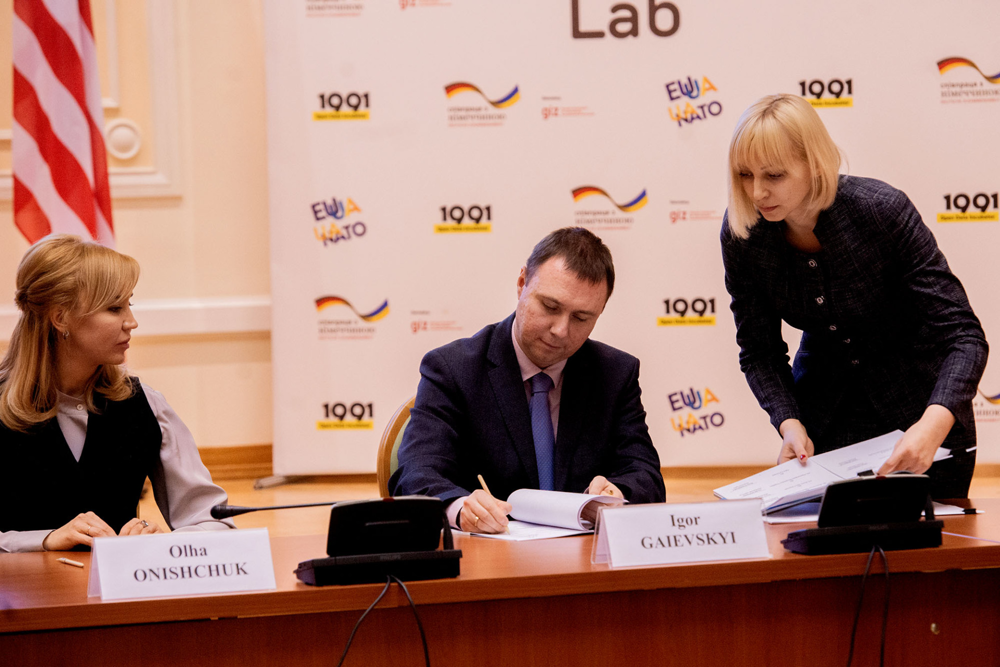
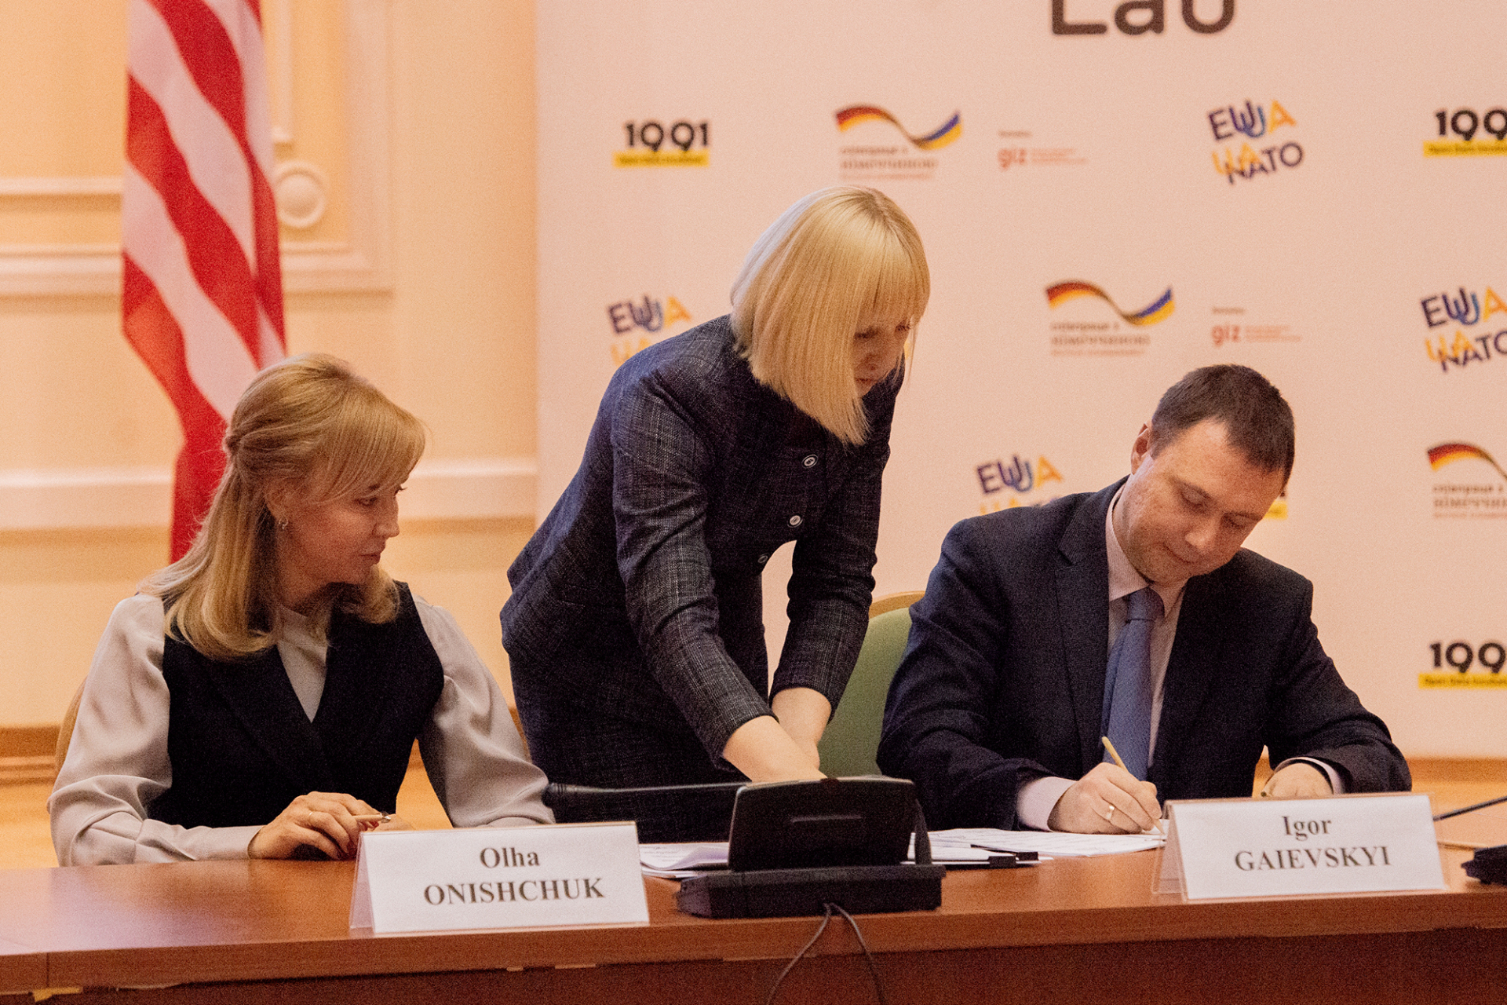
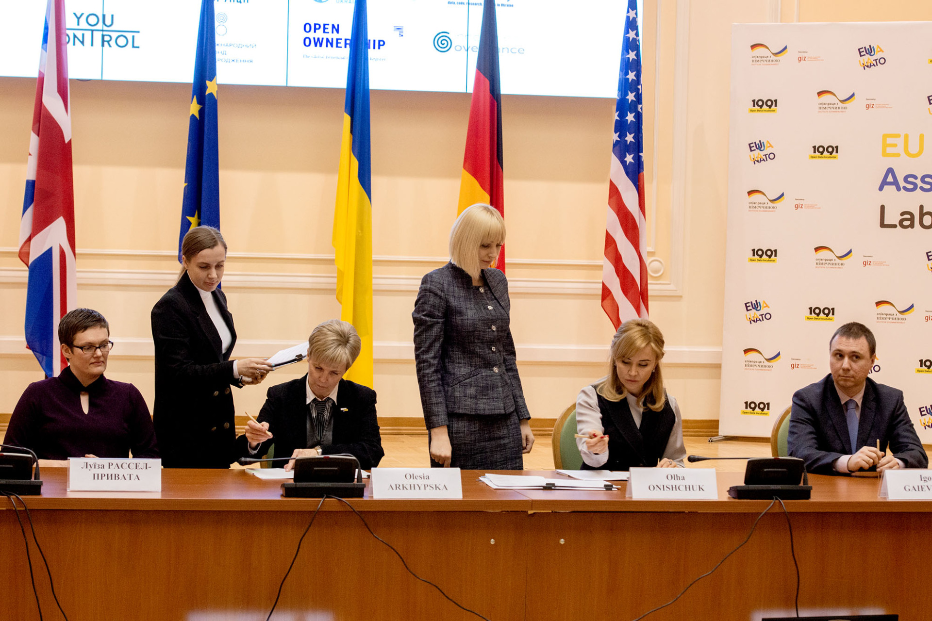
Signing of the Memorandum on strategic partnership on development of the mechanism of check of the information on UBO (Ultimate Beneficiary Owners) and Establishment of the first Transnational Electronic Laboratory

Slide 9
Lessons learned
Global Approach
Interoperability
Transnational mechanism
for information verification

Slide 10
THANK YOU!
Oksana REITER
Head of the International Cooperation and
Protocol Department
Ministry of Justice of Ukraine
+ 38 044 279-59-24
o.reiter@minjust.gov.ua

