Slide 1
PUBLIC FINANCE TRANSPARENCY AND ACCOUNTABILITY:
LEARNINGS FROM LITHUANIA
Ingrida Kalinauskienė | ingrida@transparency.lt

Slide 2
5 BILLION EUROS EACH YEAR

Slide 3
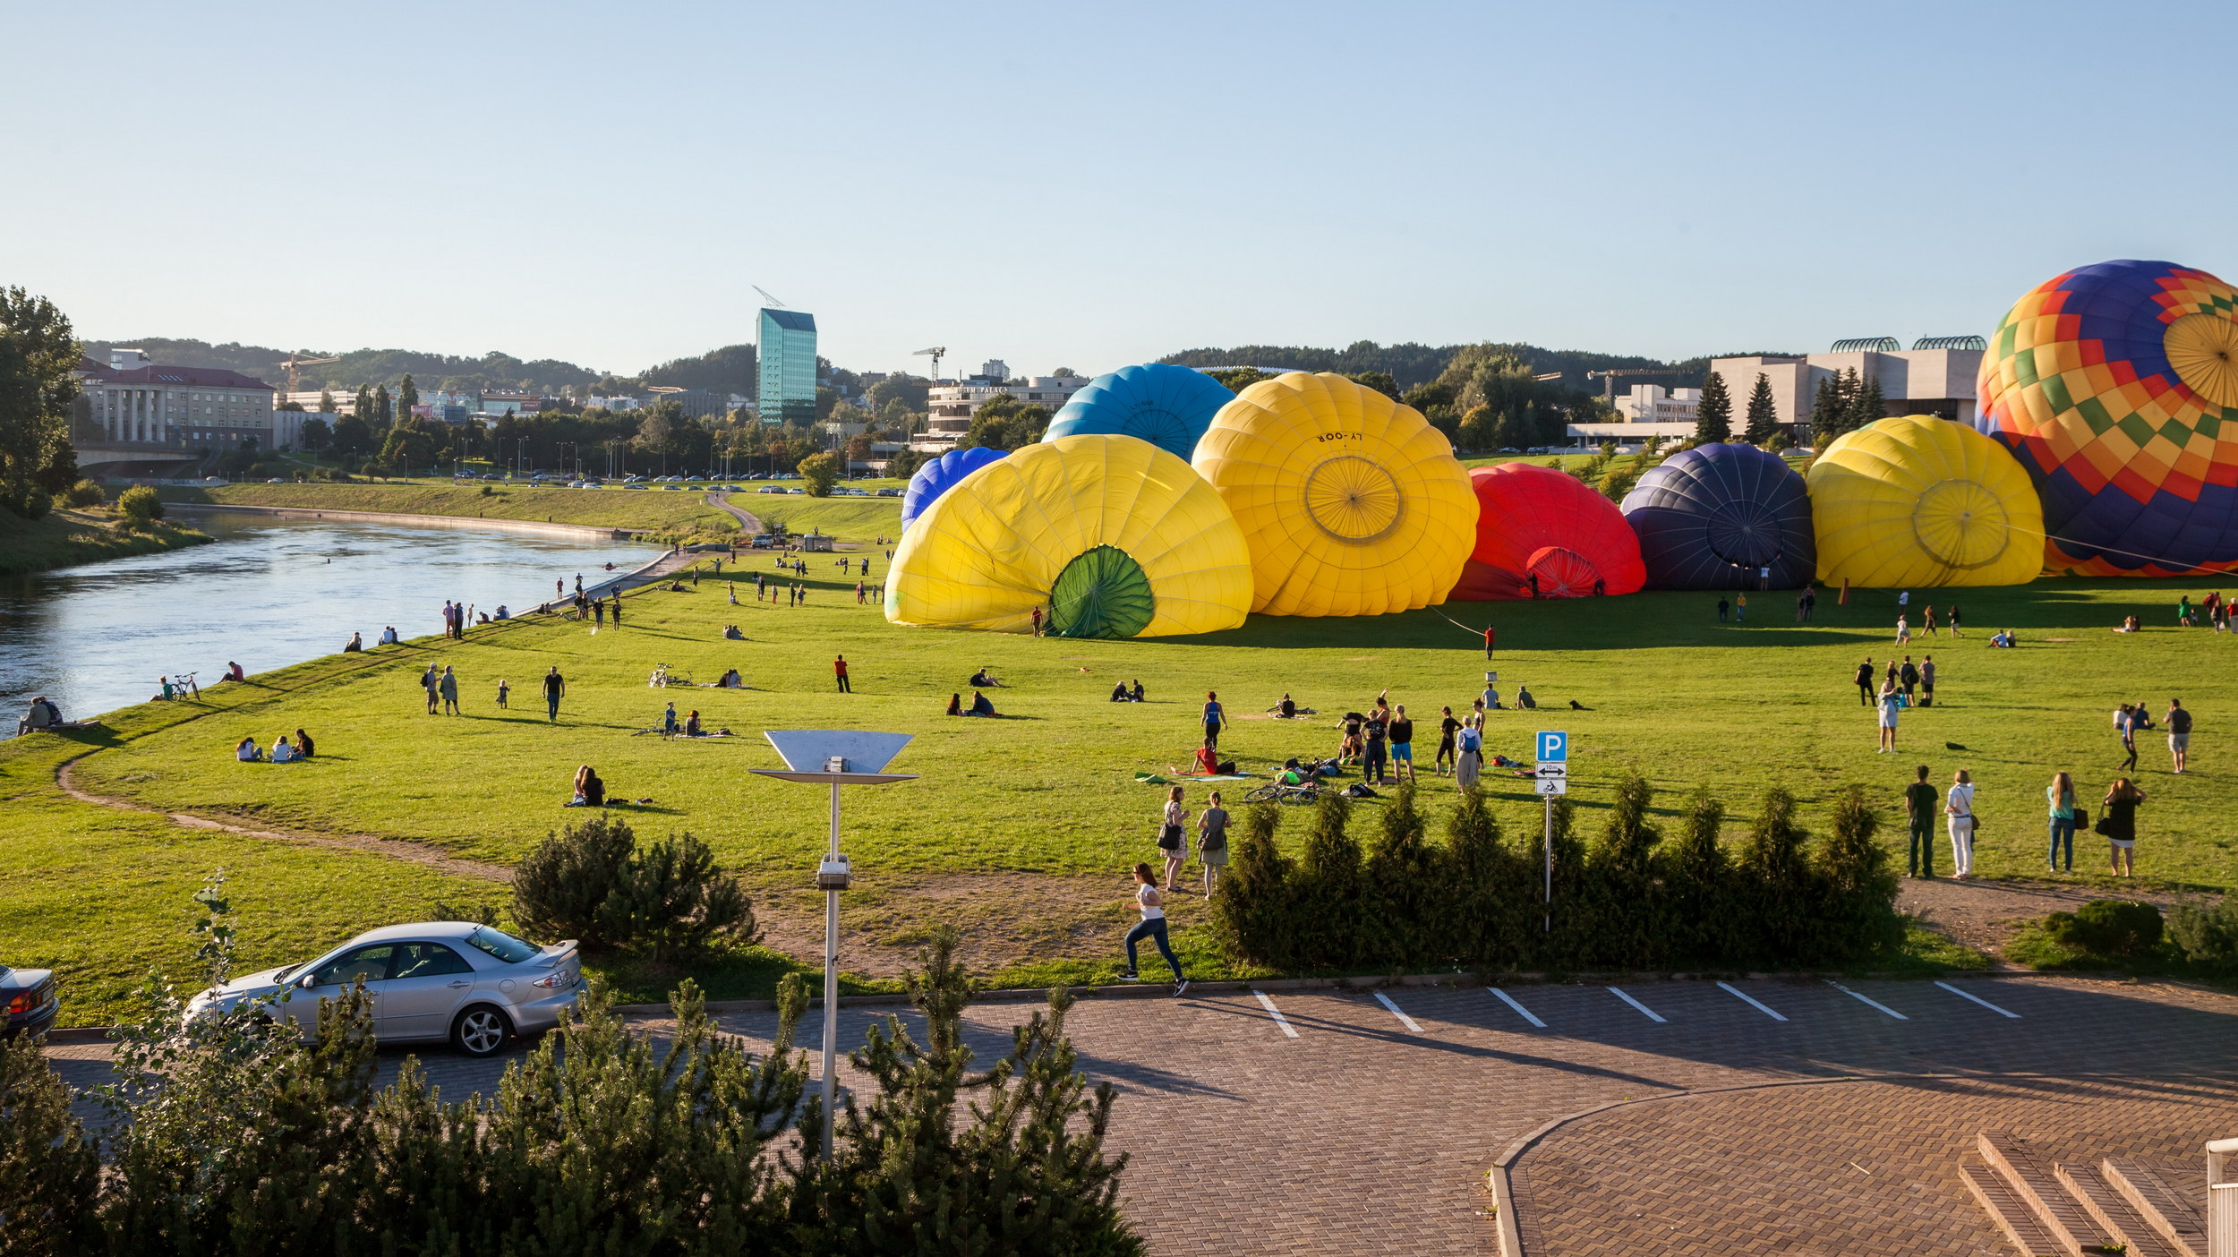
RECONSTRUCTION OF THE NERIS RIVERSIDE
EUR 11,4 million

Slide 4
PARTICIPATORY BUDGETING AS AN EXERCISE IN TRANSPARENCY

Slide 5
TRANSPARENCY
IS A HABIT

Slide 7
IF YOU WANT TO MAKE
A DIFFERENCE, THINK…
CONCRETE, MEASURABLE
AND ACHIEVABLE GOALS

Slide 9
THANK YOU!
www.transparency.lt
www.facebook.com/TILietuva
ingrida@transparency.lt

