Slide 1

FIRST E- COMPLAINT SYSTEM
REFORM TO PROMOTE TRANSPARENCY AND IMPROVE PROCUREMENT
SOCIAL IMPACT
JONAID MYZYRI
CHAIR
PUBLIC PROCUREMENT COMMISSION

Slide 2

LAW 162/2020 “ON PUBLIC PROCUREMENT”
PPC
The Public Procurement Commission is the highest administrative body in the field of procurement, which reviews complaints about procurement procedures and performs any other task assigned to it by this law and other legal acts within its scope of competence.
The Public Procurement Commission consists of the chairperson and 4 members. One of the members is elected deputy chairperson.

Slide 3
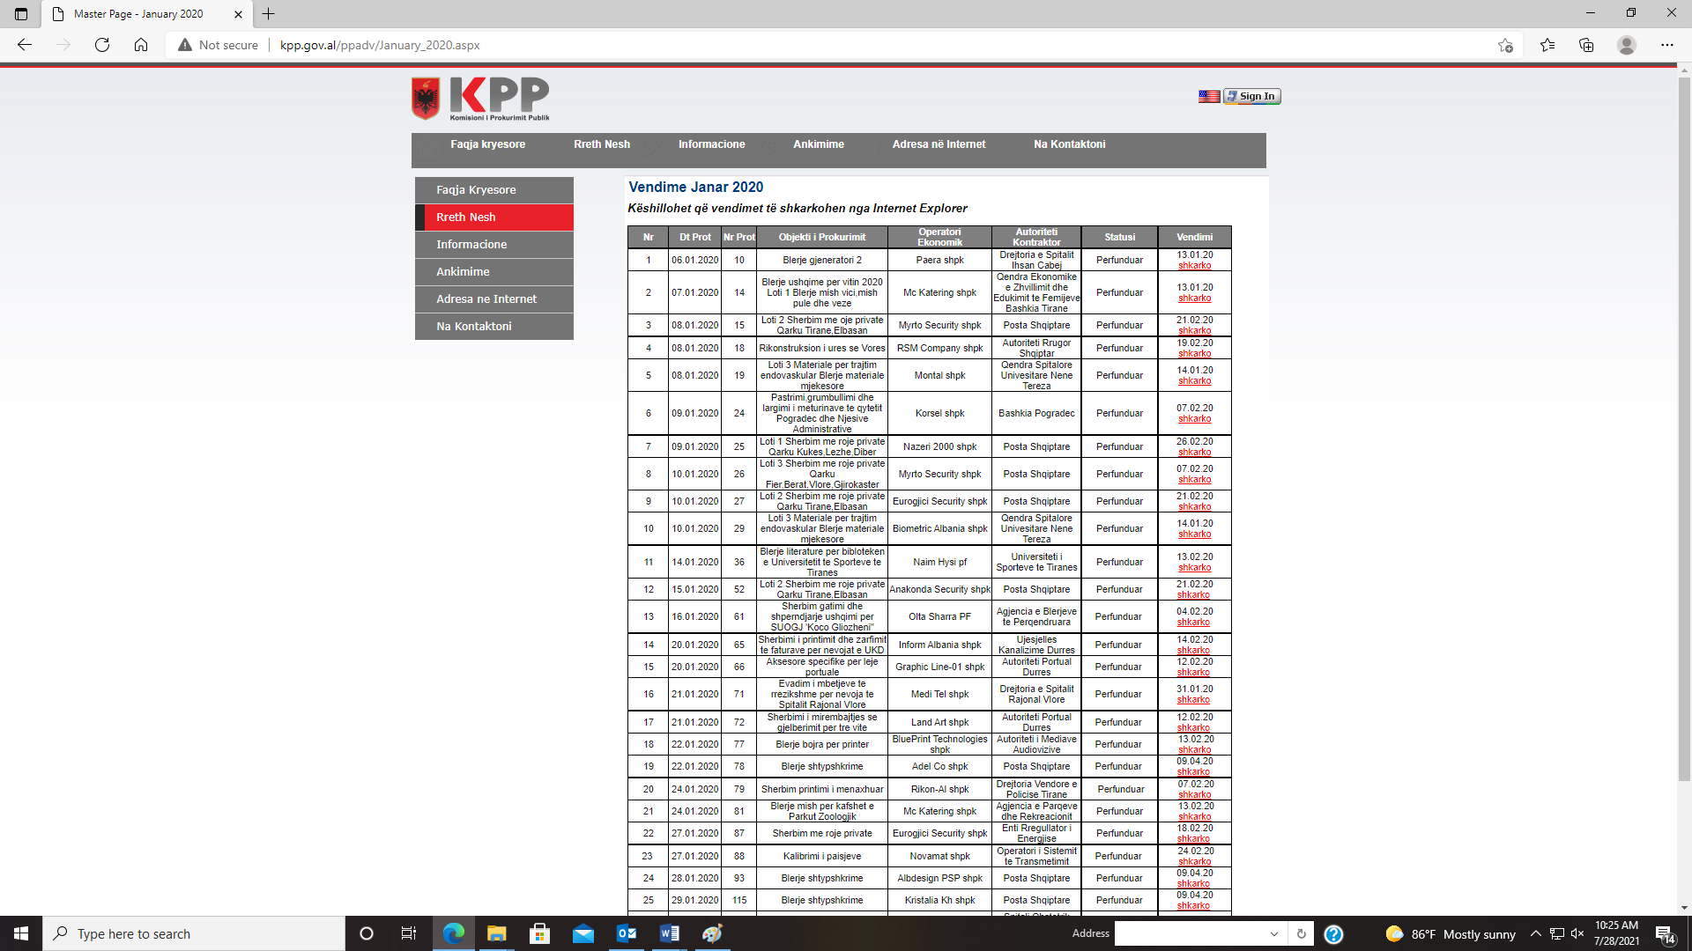
2010-2021
Starting from 2010 , only the complaint to the contracting authority and to the Public Procurement Commission has been outside the Electronic Procurement System. All other stages of the procurement procedure take place on-line
An economic operator, whose headquarters are outside the city of Tirana, for filling a complaint with the PPC has at least $ 300 extra costs/ year (transport, parking, staff) for submitting the complaint to the PPC.
Decisions not published based on Open Data principles, does not have a proper decision-making database Lack of Transparency.
Lack in processing and extracting statistical data or generating real-time analytical reports Lack of access to real-time, efficient use of systems, information to achieve the goal.
Extra cost for business ( calculated around 300 $ per year only for fuel, postal service and other administrative costs.

Slide 4
NEW E-COMPLAINT SYSTEM
E-COMPLAINT MANAGEMENT SYSTEM
Electronic system for submitting complaints and their management to the Public Procurement Commission regarding public procurement procedures, concessions and public-private partnership, auctions and mining permits, as well as improving the infrastructure for system support and work infrastructure in the offices of PPC through a centralized system.
Users
Public Procurement Commission
Public Procurement Agency
All contracting authorities within the meaning of public procurement law
All sales authorities
All contracting authorities (within the meaning of the law on concessions and ppp)
Mining permit procedures development authorities.
All domestic and foreign economic operators

Slide 5
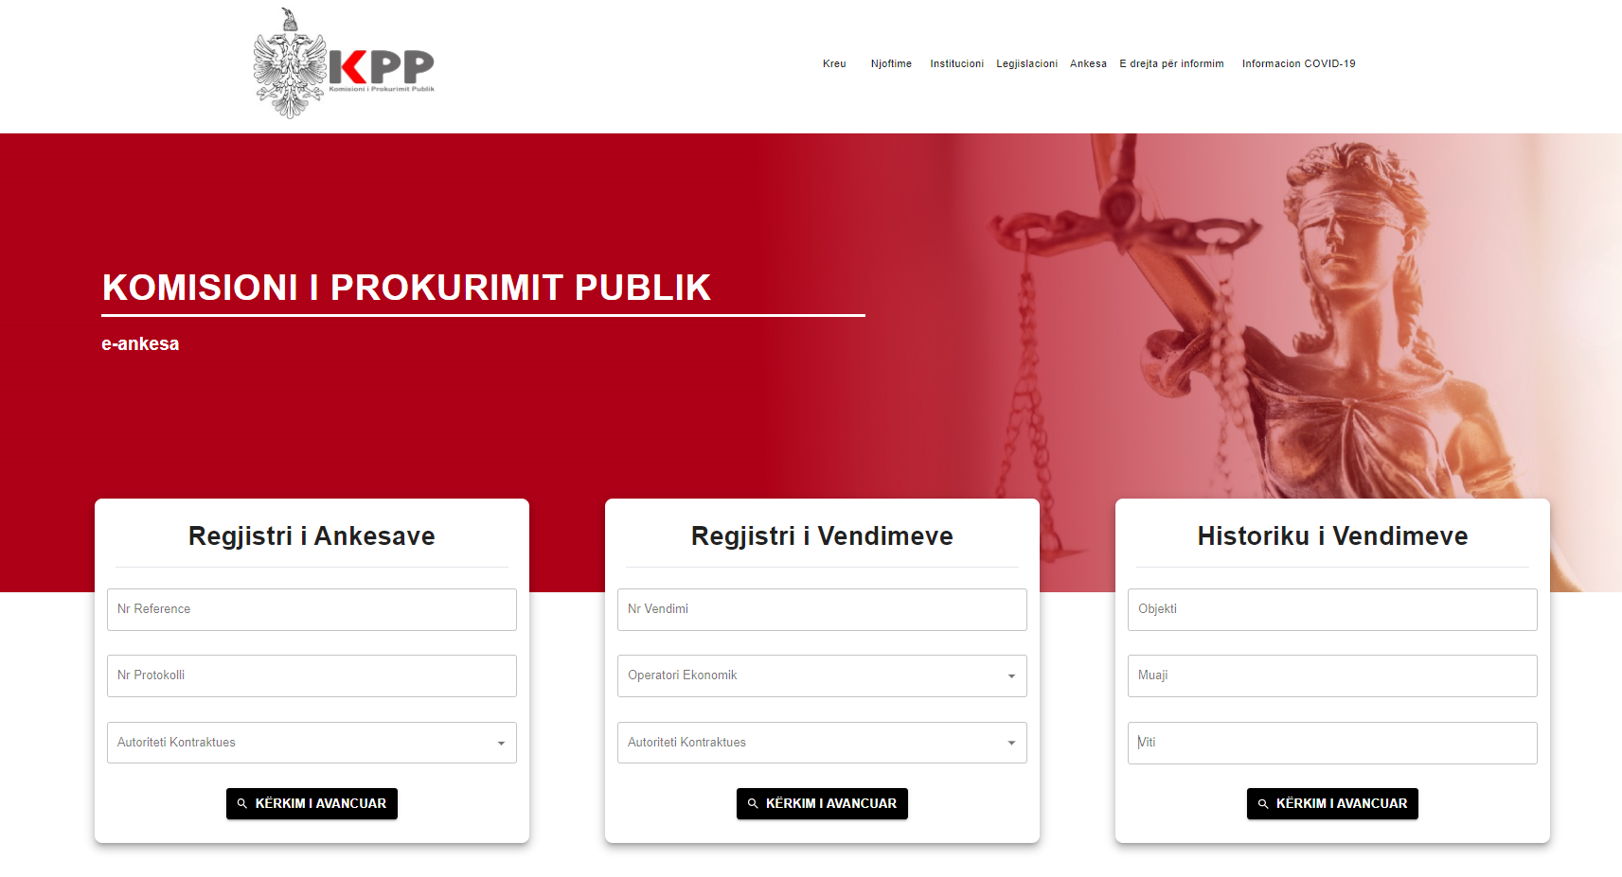
NEW STANDARD OF PUBLISHING DATA IN AL
For the search of Complaints and Decisions in real time as well as in the history of Decisions, the smart search section has also been implemented in the portal:
In the register of complaints:
  Reference number
  Protocol number
  Contracting Authority
In the register of decisions:
  Decision number
  Economic operator
  Contracting Authority
In the history of decisions
  Object of procurement
  Month
  Year

Slide 6
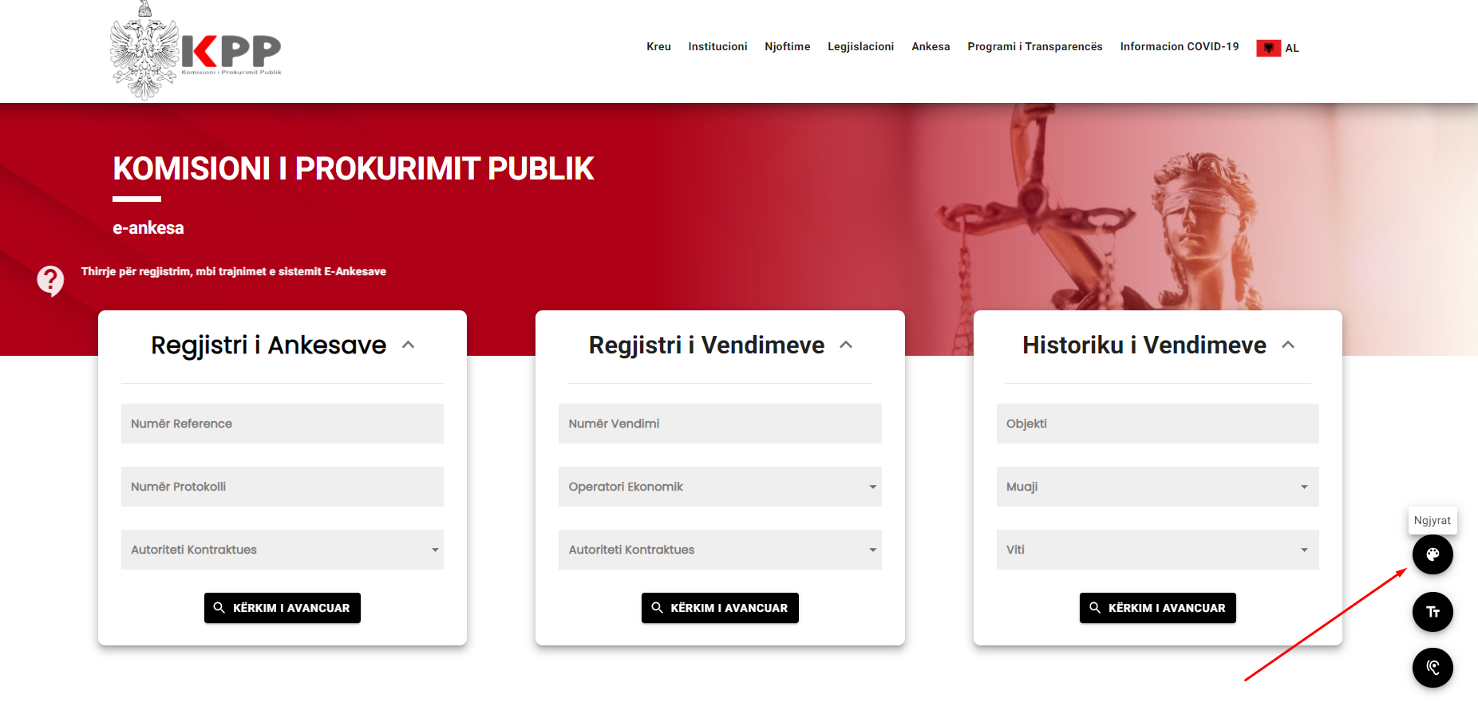
ACCESSIBILITY
First website of the government institution in #Albania that is accessible to people with #visualimpairments: #Lowvision, #colorblindness and #blindness).
Through this system, we aim to #increase #transparency in #procurement and bring it closer to stakeholders, create #access to #information for people with #disabilities and return society's attention to raising awareness of equality for people with disabilities, in particular by guaranteeing the means of support and assistance for equal opportunities and conditions with others.

Slide 7
ACCESS FOR PERSON

Slide 8


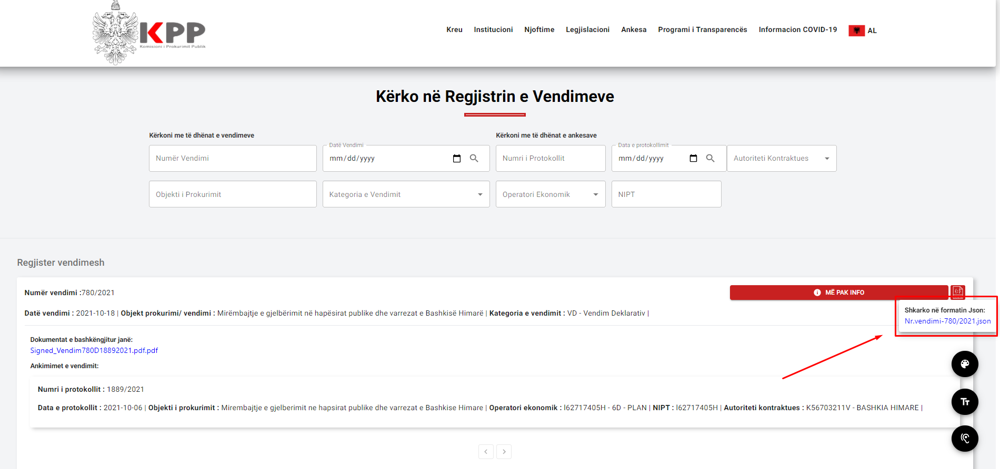
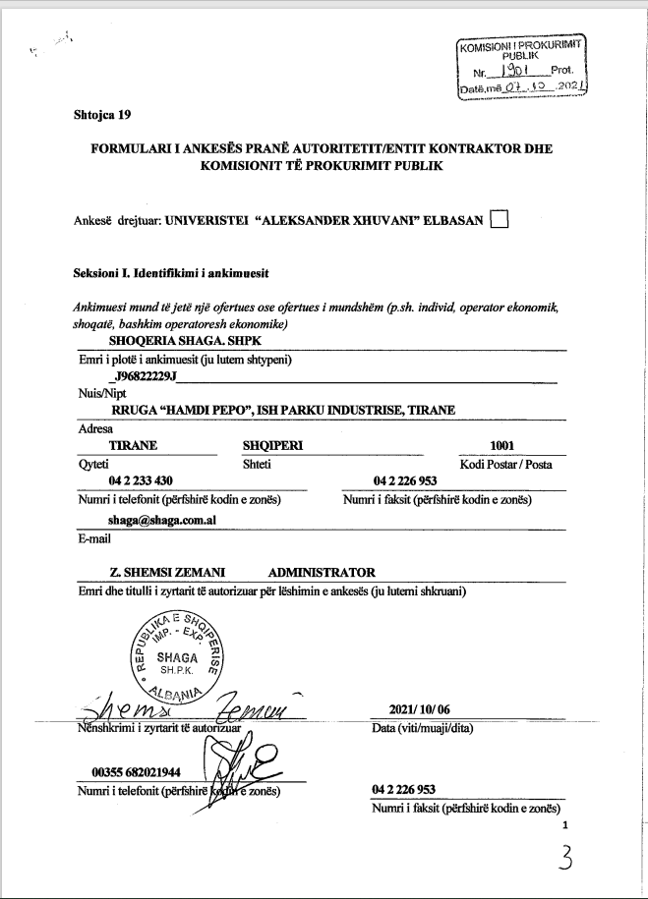
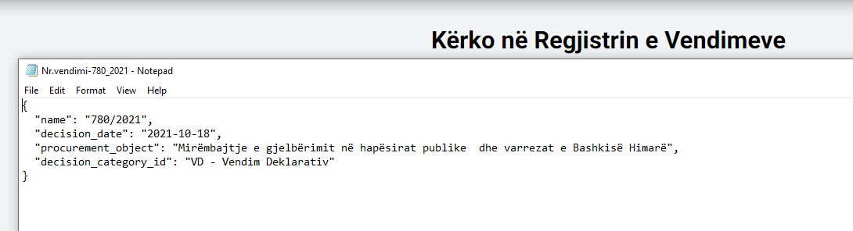


COMPLAINTS REVIEW SYSTEM ALBANIA DIGITAL TRANSFORMATION AND OPEN DATA
Analogue/digital
ANALOGUE/ DIGITAL

Slide 9
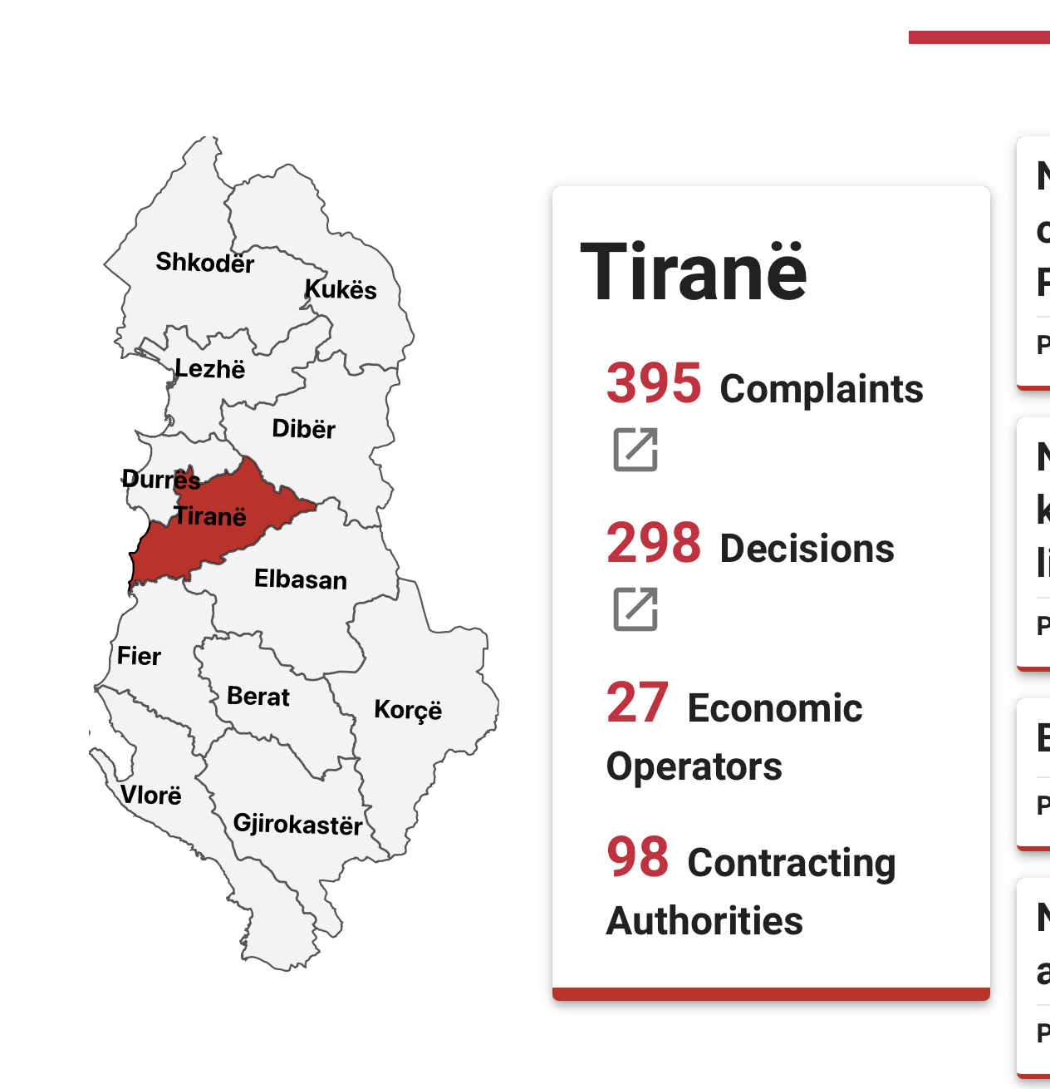
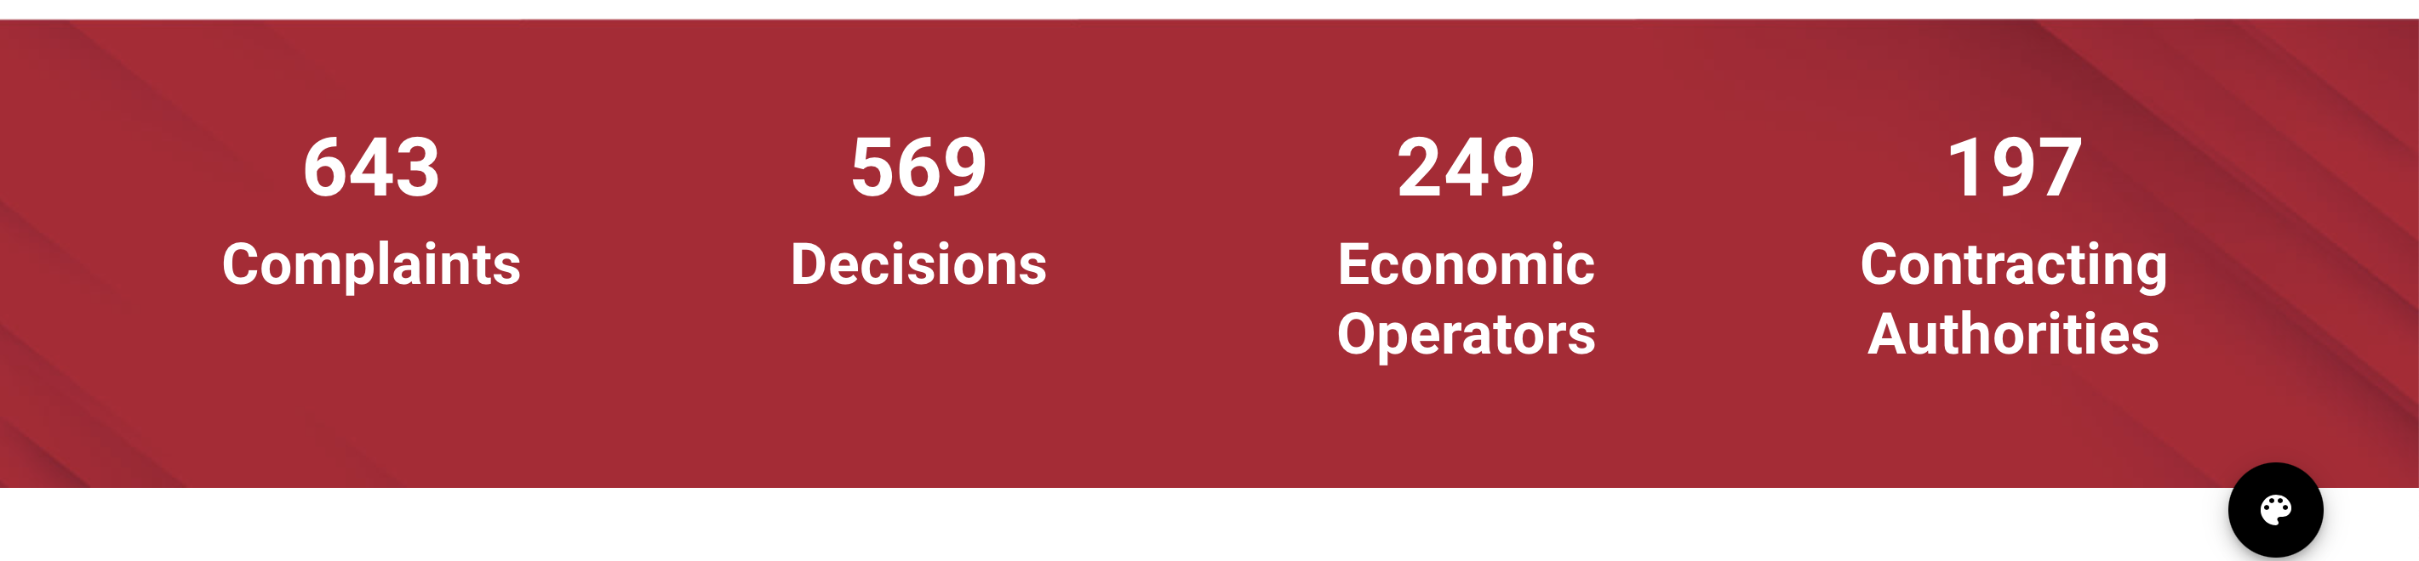
REAL TIME DATA

Slide 10
REAL TIME DATA

Slide 11
SOCIAL IMPACT OF PUBLISHING DATA
There are a lot of lessions to be learned through complaint review process
Through publishing data economic operators and contracting authorities , CM and parliament can identify problems in procurement system.
3. Decreese the number of complaints
4. Increase the speed of reviewing process for goods, services and public works procedure
From 22 % during 2020 of complaints review after the legal deadlines to 7.4 % in 2021 in PPC
5. Increase the accountability
6.Increase the control, easy way to controll by State Audit, Anti Corruption Agencies
7. Boost the way of spending public money

Slide 12
THANK YOU

