Slide 1
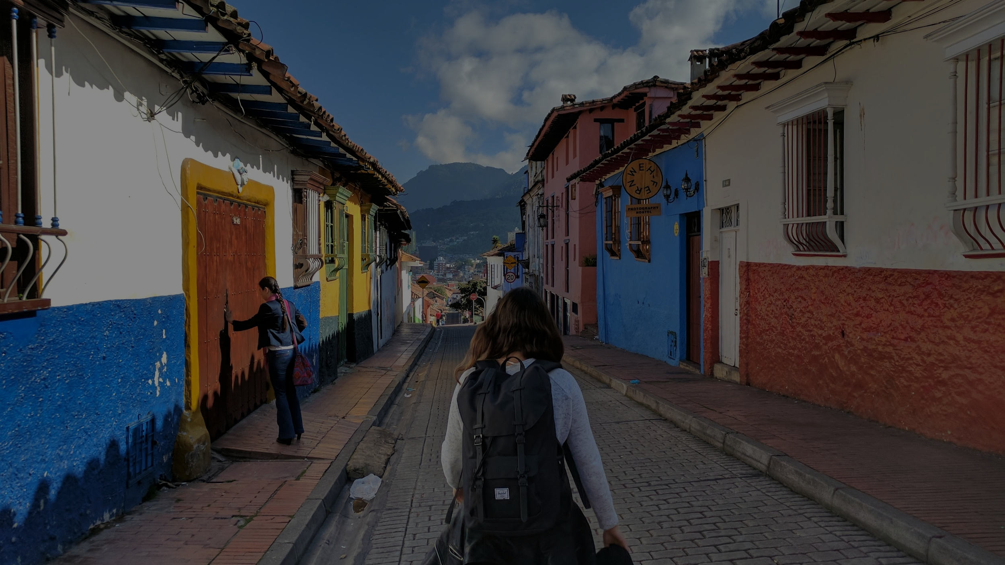

Western Balkans
Regional Meeting
2021

Slide 2
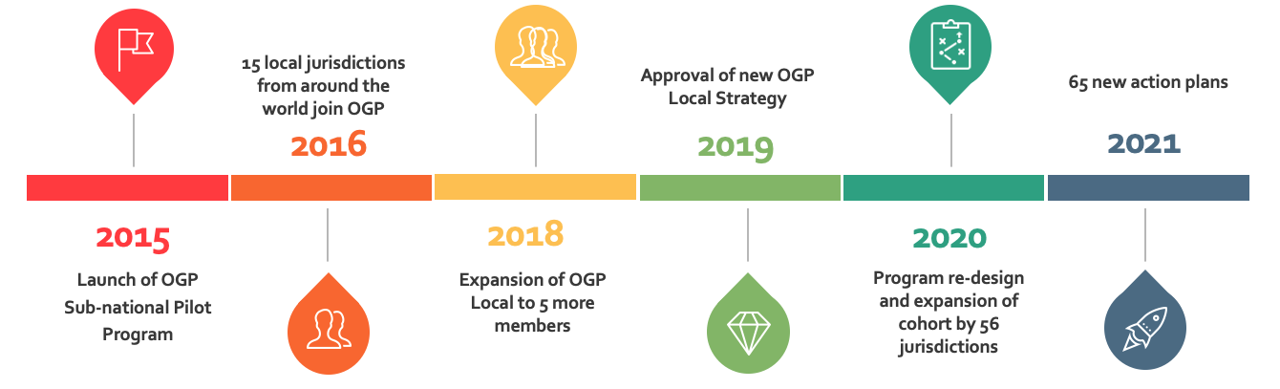

OGP Local Trajectory

Slide 3




Who We Are: Meet the Team
Rudi Borrmann
Deputy Director
José María Marín
Sr. Program Officer
Patrick
Kazyak-Albaladejo
Program Officer
Clorinda Romo
Learning & Community

Slide 4
Why Local?
Closer to Citizens
Deliver Main Public Services
Easier to Measure
Laboratories for open and collaborative innovation
Great platform for localizing 2030 Agenda
Citizens can play a key role in co-creation
70% of the world population projected to live in urban areas by 2050 (UN 2019)

Slide 5
Local Results*
Participatory Policymaking
Participatory Budgeting
Infrastructure Monitoring
*2016-2018 Pioneer Program
Notes:
The Independent Reporting Mechanism (IRM) has assessed 152 commitments made by the 20 pioneer OGP Local members over the last five years. Overall, IRM analysis has found that local commitments are, on average, significantly more likely to be ambitious and achieve strong early results than commitments made by national governments.

Slide 6
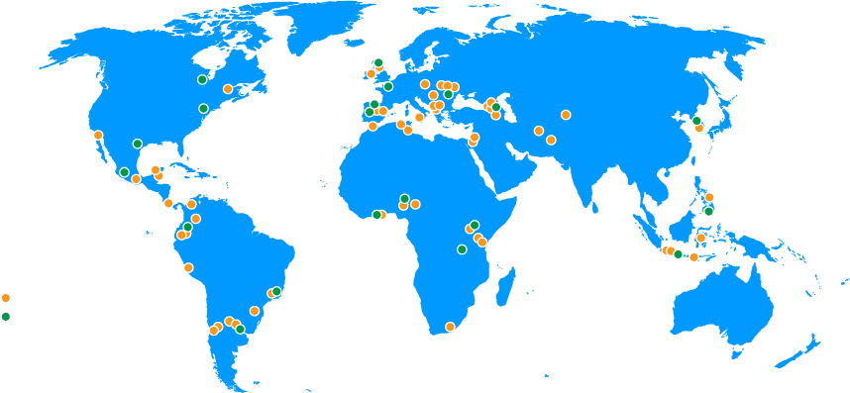
OGP Local Members
New OGP Local Jurisdictions
OGP Local Pioneers
Notes:
OGP Local works with 76 jurisdictions including regions, states, provinces, counties and cities in:
Africa and the Middle East
Americas
Asia-Pacific
Europe
Eastern Partnership

Slide 7
New OGP Local Strategy
Local Cohort
  Scalable, sustainable, responsive, inclusive & innovative
  New rules, more flexibility
  Local approach to monitoring and evaluation
Knowledge & Sharing (OGP Local Compass)
  Foster innovation and new themes
  Centralized onboarding and capacity building
  Hub for peer exchange, learning and innovation resources
National - Local Collaboration
  Focus on promoting strategic collaboration based on best practices
  Strategic alignment with Local members
  Context relevant approaches

Slide 8
New OGP Local Strategy
Local Cohort
  Scalable, sustainable, responsive, inclusive & innovative
  New rules, more flexibility
  Local approach to monitoring and evaluation
Knowledge & Sharing (OGP Local Compass)
  Foster innovation and new themes
  Centralized onboarding and capacity building
  Hub for peer exchange, learning and innovation resources
National - Local Collaboration
  Focus on promoting strategic collaboration based on best practices
  Strategic alignment with Local members
  Context relevant approaches

Slide 9
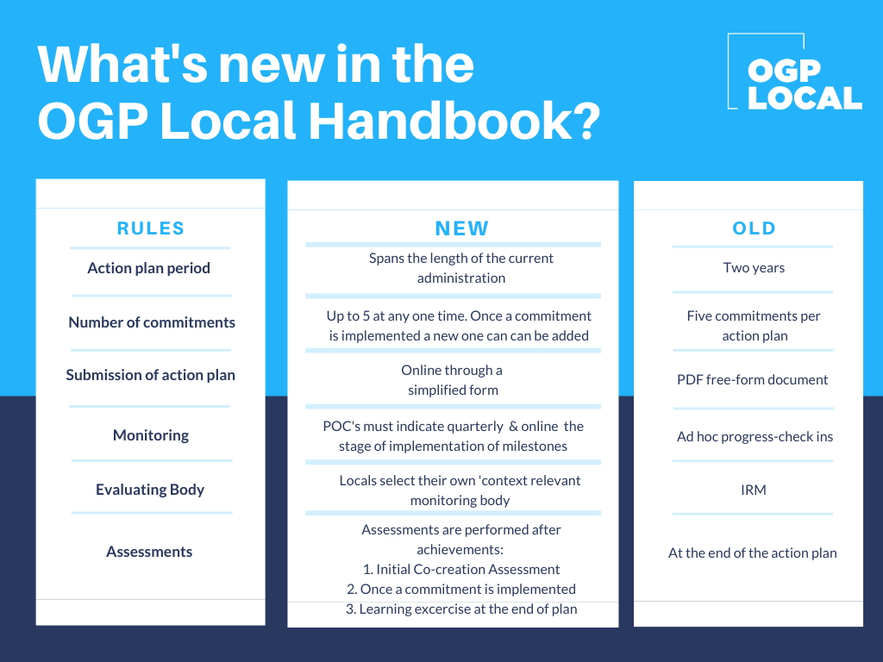


Slide 10
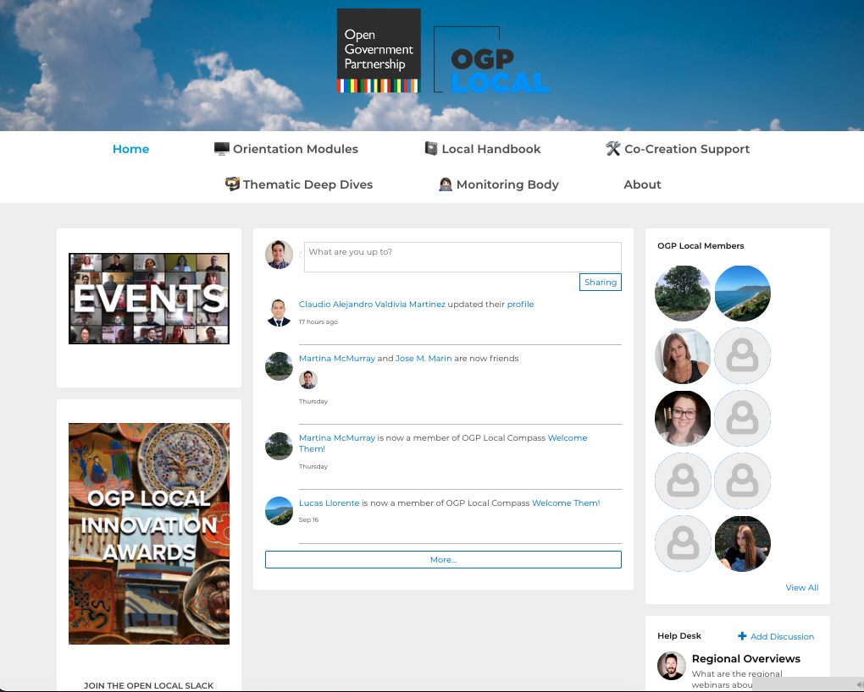
Knowledge Platform
Online knowledge sharing
Broadened community of practice
Thematic & issue-based learning circles
Knowledge products on open local government

Slide 11
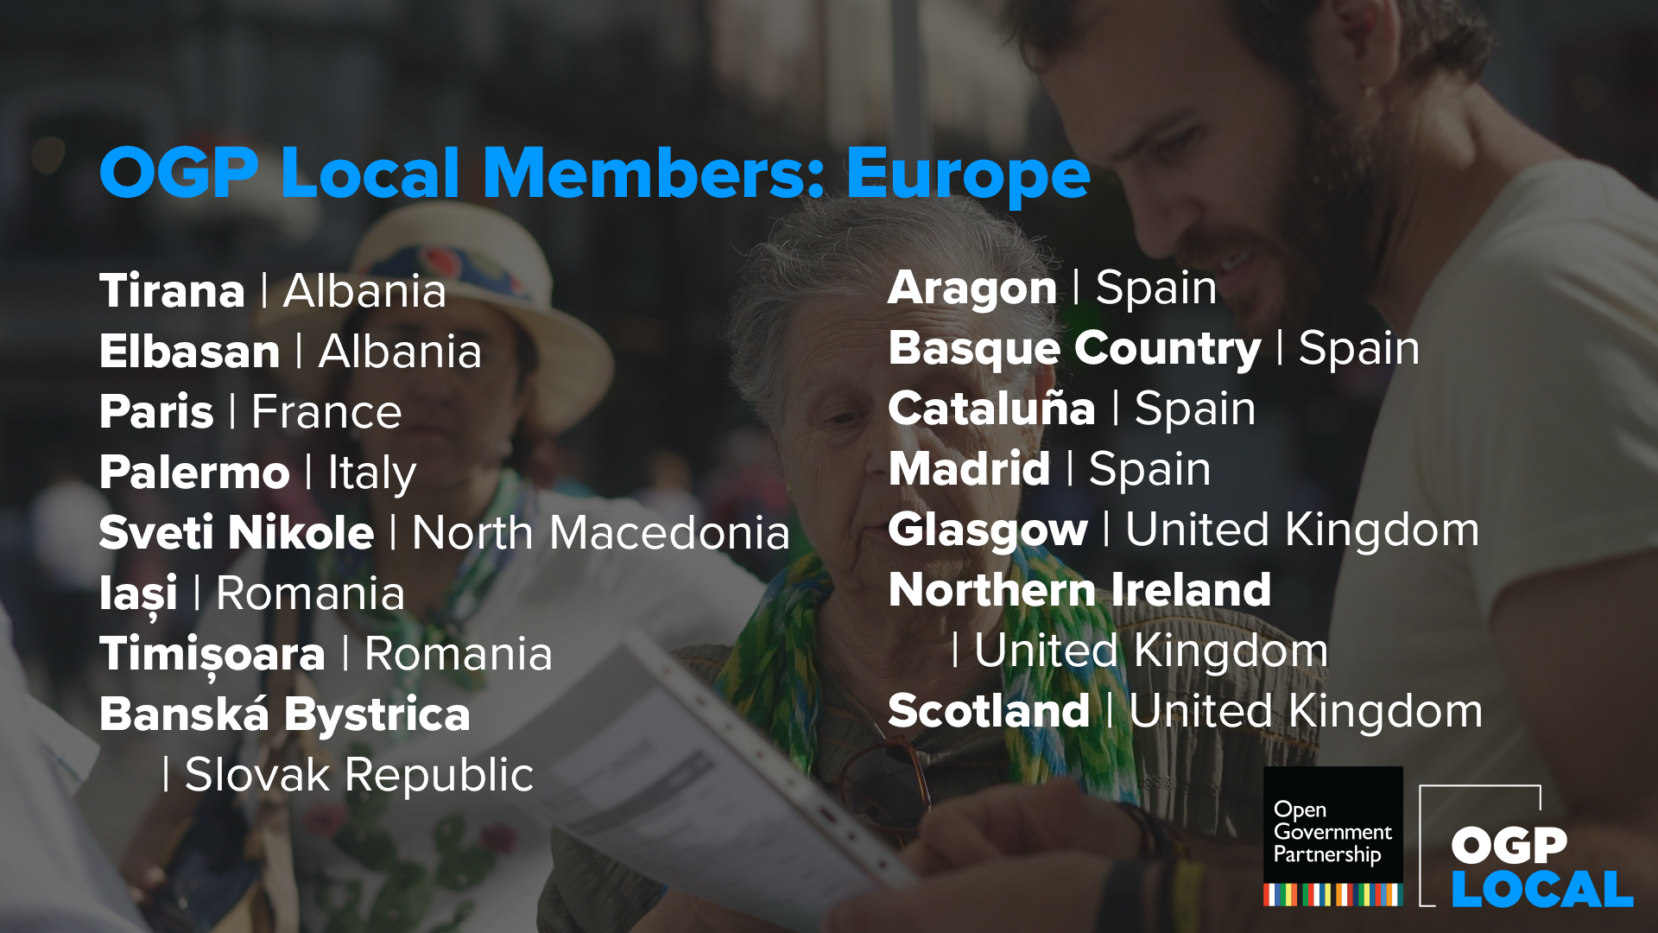

Slide 12
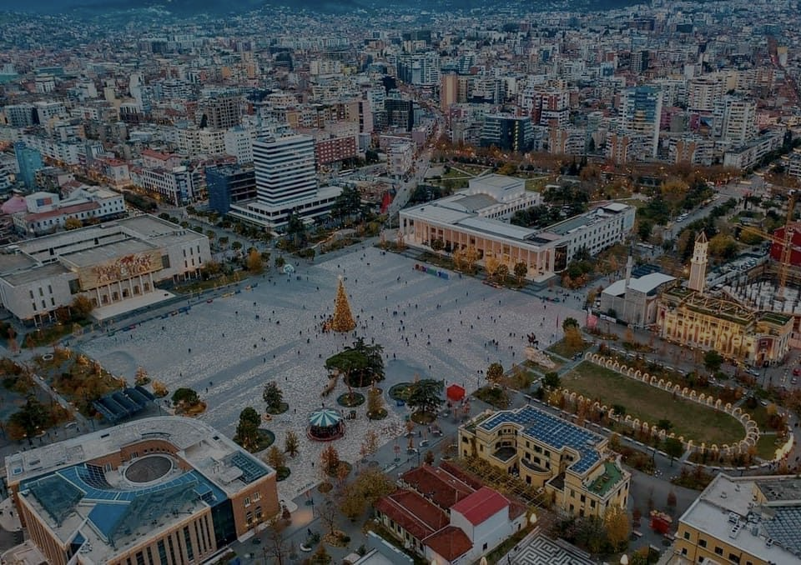
Tirana, Albania
Ina Bregaj
Head of European Union Integration Unit & OGP Local POC, Tirana Municipality

Slide 13
New OGP Local Strategy
Local Cohort
  Scalable, sustainable, responsive, inclusive & innovative
  New rules, more flexibility
  Local approach to monitoring and evaluation
Knowledge & Sharing (OGP Local Compass)
  Foster innovation and new themes
  Centralized onboarding and capacity building
  Hub for peer exchange, learning and innovation resources
National - Local Collaboration
  Focus on promoting strategic collaboration based on best practices
  Strategic alignment with Local members
  Context relevant approaches

Slide 14
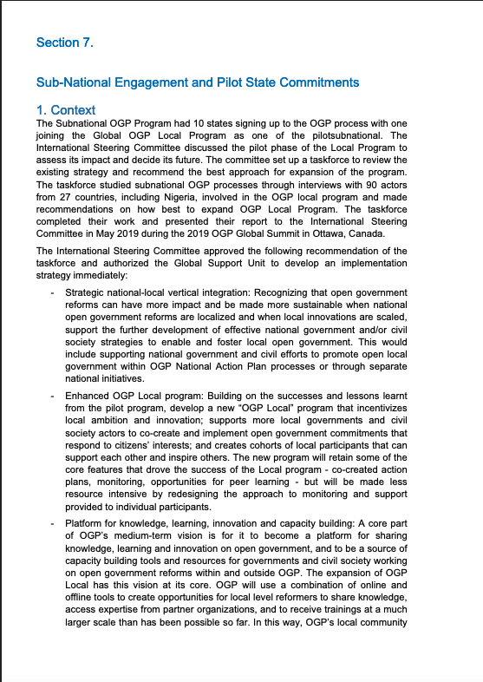



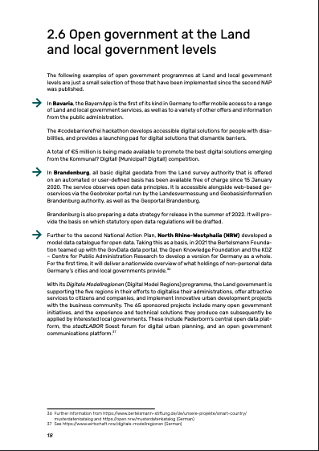
National-Local Collaboration
Long standing practice, increasing popularity
Promote strategic collaboration
Increase knowledge sharing
Understanding the diversity in contexts, approaches and goals

Slide 15
National-Local Collaboration
Goals
Advancing Open State strategies
Enhancing multi-level governance
Ensuring policy coordination
Promoting learning and innovation
Approaches
Co-creating commitments with local jurisdictions.
Commitments as frameworks for collaboration.
Commitments with implementation at local level.
Inviting submissions from local jurisdictions in national action plans.
Developing awareness and capacities among local stakeholders.
Results
Commitment implementation
Non-AP participation/actions
Increased knowledge and skills

Slide 16
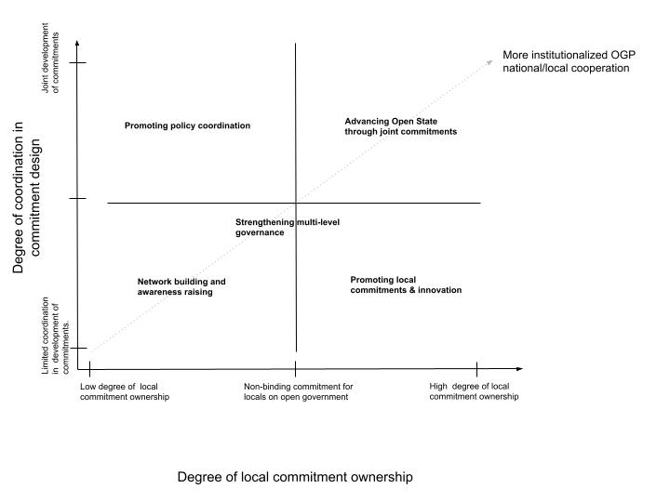
National-Local Collaboration

Slide 17
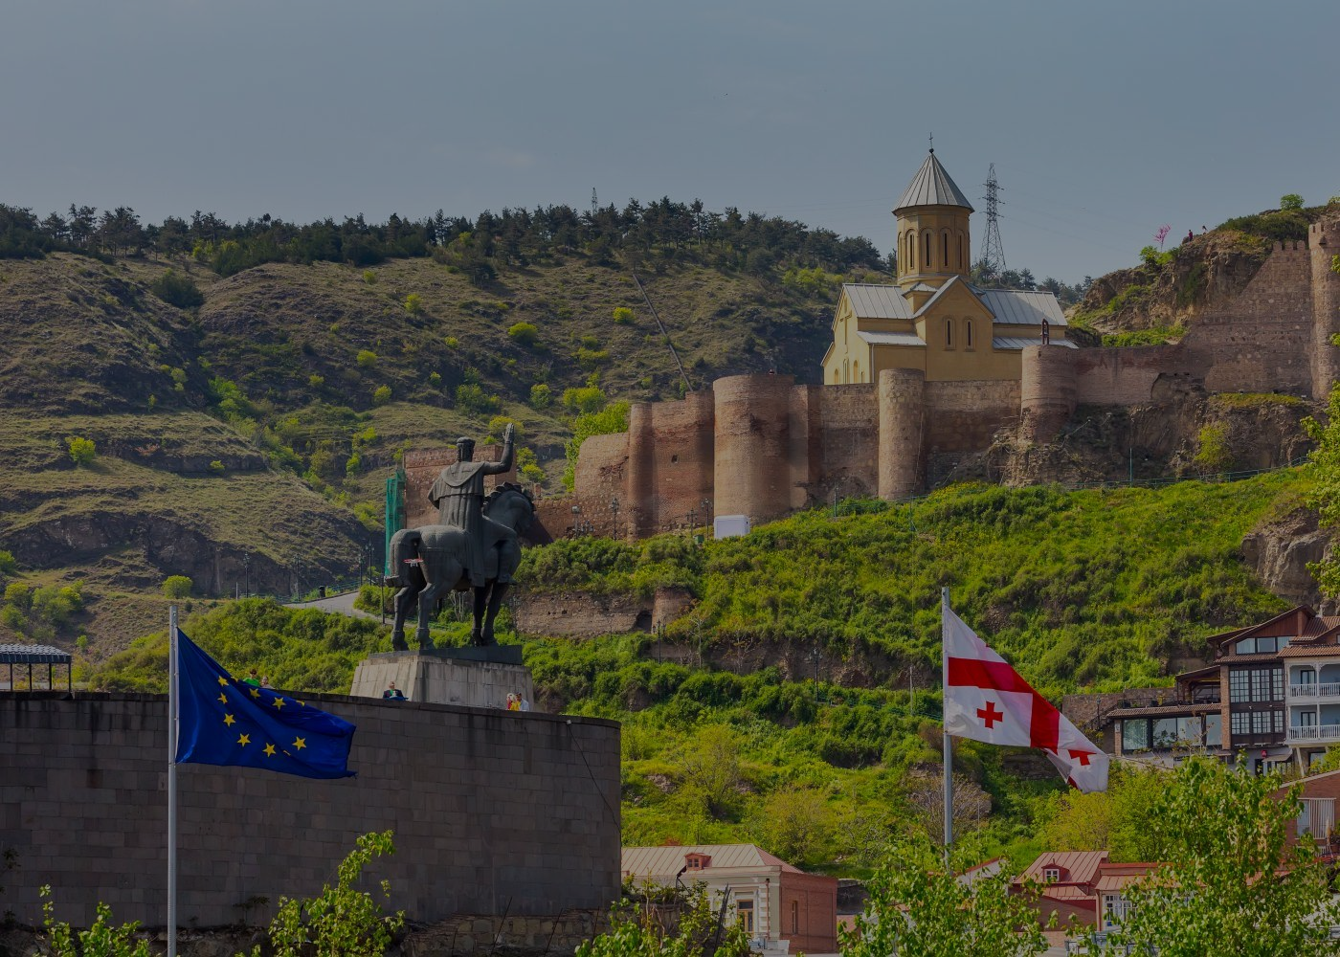
Georgia
Ketevan Tsanava
Head of Public Administration Unit, Policy, Planning and Government Coordination Department & OGP National POC, Government of Georgia

Slide 18

Local members
  Call for 50 new local members
  65 new local action plan implementation
  More than 200 commitments
Knowledge sharing platform
  Local open gov themes
  Growing community of practice
  Innovation and skills building in OG
National-local collaboration
  Showcase cases and approaches
  Spaces for peer learning
  Ad-hoc support
What to look out for in 2022

Slide 19

For more information...
Visit
  opengovpartnership.org/ogp-local/
Join
  ogplocal.slack.com
Contact
  local@opengovpartnership.org

