Slide 1

Reviewing the open data ecosystem developments in Croatia
OGP Western Balkans Regional Meeting

Slide 2
Introduction
Central State Office for Development of the Digital Society – rdd.gov.hr
Mr. Bernard Gršić, State Secretary
  The Central State Office for the Development of the Digital Society is a Croatian state administrative organization with the task of monitoring and improving the development of the digital society and complying with the guidelines and regulations of the European Union in the field of digital society and economics.
  Vision
  A developed, secure and inclusive digital society achieved through the synergy of the economy, public administration, science, research and education.
  Mission
  Support to the Government of the Republic of Croatia in the development of secure digital infrastructure and public digital services and popularization of the development of digital society in all areas of life and activity of Croatian citizens, economy and public sector.
Božo Zeba, Sector Coordinator
  Master of Transport and Traffic, since 1999, (un)successfully studying system engineering since 2017 (lifelong learning)
  10 years in the telecommunications sector (mobile operator), 12 years in central public administration bodies
  Projects: e-Citizens, Shared service centre,HITRONet, eIDAS - Access to e-services of the Republic of Croatia for EU/EEA citizens, MIS - Information system for managing EU funds, Open Data Portal…

Slide 3
Content
Legal framework
Organizational framework
Open data ecosystem
Force-field analysis
Data value perspectives
Methodology for assessing the impact of open datasets
About the EU project...
Technological architecture of the new system

Slide 4
Legal framework
Directive (EU) 2019/1024 of the European Parliament and of the Council of 20 June 2019 on open data and the re-use of public sector information – deadline for transposition into national law – 17th July 2021.
Right to Access to Information Act („Official Gazette“, No. 25/13. i 85/15.) – new one is in procedure of public consultation
  Ordinance on the Cost of Re-use of Information, (Official Gazette 87/2018)
  Criteria for the Determination of the Fees for the Actual Material Costs and the Costs of the Delivery of Information (Official Gazette 12/2014, 15/2014)
  Ordinance on the Structure, Content and Manner of Keeping of an Official Register on the Exercise of the Right to Access and Re-use Information (Official Gazette 83/2014)
  Ordinance on the Central Catalogue of Official Documents of the Republic of Croatia (Official Gazette 124/2015)
  Ordinance on the Content and Manner of Keeping the Record of Exclusive Rights to the Re-Use of Information (Official Gazzette 20/2016)
  Ordinance on Types and Content of Licences Establishing Terms and Conditions of the Re-Use of Information (Official Gazzette 67/2017);

Slide 5
Organizational framework
EU level
Open Data Committee – representatives of member states
National level
  Ministry of justice and public administration
  Central State Office for Development of the Digital Society
  Government Office for Cooperation with NGOs
  Information Commissioner
Every institution must have appointed Information Officer!

Slide 6







Open data ecosystem
Public dataset catalogue
Single access point for public pen datasets
Open formats (json, csv, xml, kml..)
access via API!
validation, analytics and gamification
data.gov.hr
health
environment
social responsibility
industry
smart cities
intelligent mobility
agriculture
science

Slide 7

Force-field analysis
FOR change | Grade*
Open data projekt | 5
Legal framework | 3
Open data policy | 2
High value datasets | 0
Open Data Ecosystem in Croatia
AGAINST change | Grade*
No awareness in public bodies | 8
Lack of knowledge about open data | 7
No digitalized data | 3
Technology obstacles | 1
* Scale from 1-10

Slide 8
Data value perspectives
perspective
Re-users perspective
Economic
Social
Dataset value
Measurement ex-ante
Measurement ex-post
Political
Dataset publisher perspective
Environmental
time
data set value the ability of "re-user" to use them

Slide 9
Methodology for assessing the impact of open datasets
Opendatabarometer (2015): impact assessment is one of the most challenging segments
Only 15 Member States of the European Union (54%) have an impact measurement methodology
Impact assessment methodology - mainly surveys and web-log analysis (common tool is google analytics)
ex-ante
qualitative assessment of the potential impact of open datasets
theoretical assumptions and case analysis
Dataset value publication
Dataset value usage
ex-post
quantitative analysis of the achieved impact of a set of open data
empirical analysis

Slide 10
Methodology for assessing the impact of open datasets
  Methodology allows you to rank different datasets according to:
  1) Total impact index value of open data set (A)
  2) Economic Impact Index (B)
  3) Social Impact Index (C)
  4) Political Influence Index (D)
  5) Environmental Impact Index (E)
  6) Usage Index (F) - Ex-post
  Where A = B + C + D + E + F
So, the definition is:
The ex-ante index of the total impact of the open data set is the weighted sum of four sub-indices that measure the four categories of influence of the open data set – economic, social, political and environmental, with addition of usage index for ex-post index measurement

Slide 11
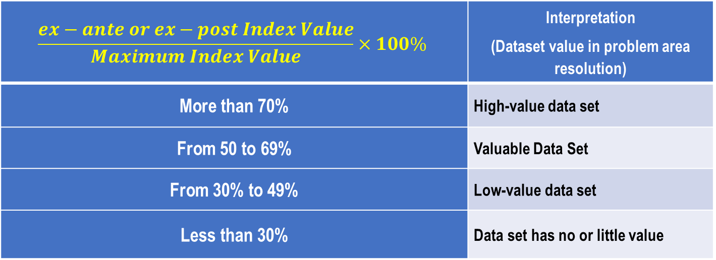
Methodology for assessing the impact of open datasets
In order to be able to identify high-value datasets based on the ex-ante and ex-post impact index of the open dataset, it is proposed to use a value scale
$$\frac{ex−ante or ex−post Index Value}{Maximum Index Value}×100\%$$ | Interpretation (Dataset value in problem area resolution)
More than 70% | High-value data set
From 50 to 69% | Valuable Data Set
From 30% to 49% | Low-value data set
Less than 30% | Data set has no or little value

Slide 12
About the EU project...
Project name: Adaptation of public sector information systems to the Open Data Portal
Project implementation period: 36 months (28 May 2019 to 28 May 2022). Total project value: HRK 6,798,000.00 (85% co-financed by the EU from the European Social Fund under operational programme "Effective Human Resources" 2014-2020).
adapting public sector body information systems to the Open Data Portal
increasing the quality of publication and the number of open datasets of public authorities
Increase open datasets users
strengthening the capacity of state and public administration employees
increasing re-use of datasets by targeted project beneficiaries and other stakeholders
technological and visual improvement of the Open Data Portal

Slide 13
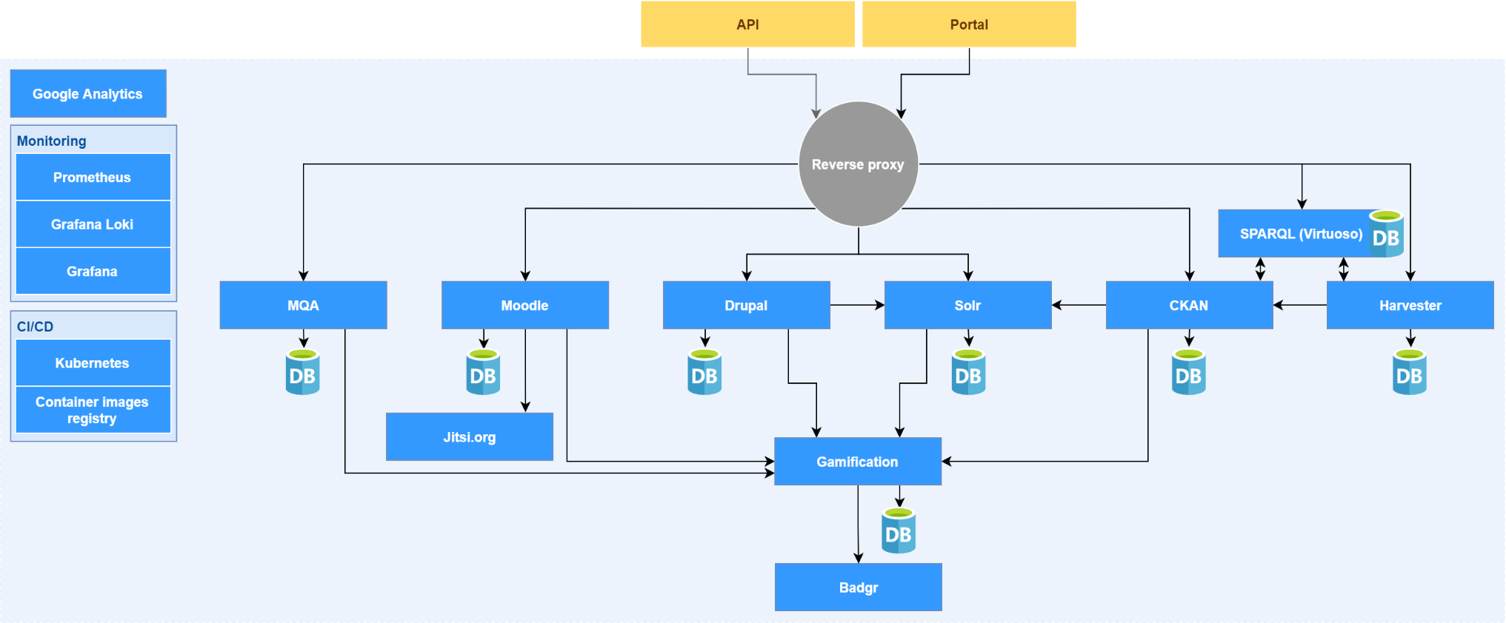
Technological architecture of the new system
Gamification module
SPARQL (Virtuoso)
MQA modul
Visualization
E-learning (Moodle)

Slide 14

Božo Zeba t: +385 1 4400 844 e: bozo.zeba@rdd.hr Ivana Lučića 8, 10 000 Zagreb, Croatia rdd.gov.hr

